Slide 1
Technology In Construction
Kranti Kiran Reddy
MD, Janapriya Engineers Syndicate
Convener Credai – Cost & Project Management

Slide 2
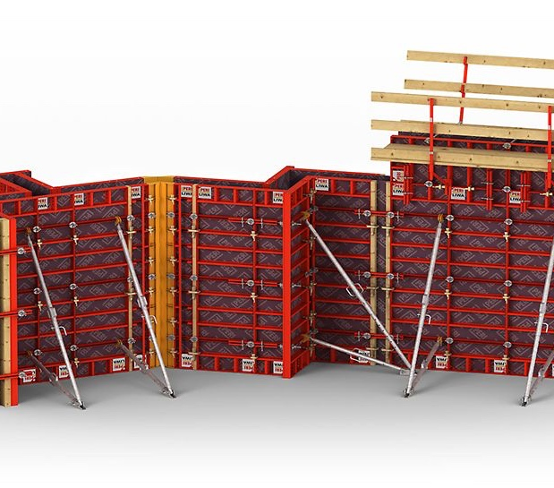
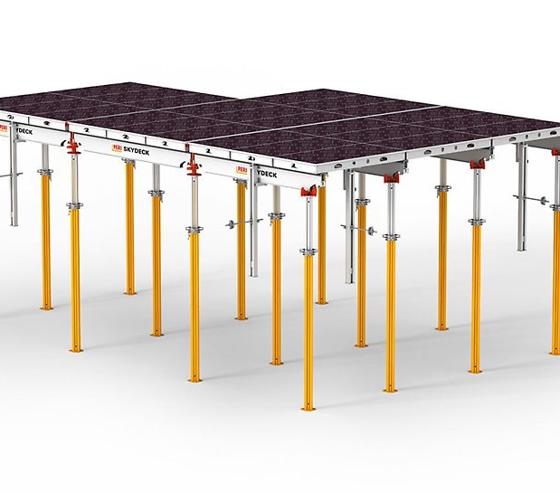
Modular Form Work – Walls & Slabs

Slide 3
Case study 100 Flats – Stilt + 5 Floors (1000 sft flats)
Building Schedule
Excavation and Works up to Plinth – 90 days
Stilt – 30 days
Super Structure – 120 days
BW & Finishes – 180 days
Total Project Time – 420 days

Slide 4
Case study 100 Flats – Stilt + 5 Floors (1000 sft flats)
Day 1: Shuttering
Day 2: Shuttering
Day 3: Reinforcement
Day 4: Conduiting & Pouring
Day 5: Deshuttering & Re-shuttering (Prop in place)
Form Work Schedule – One Set

Slide 5
Case study 100 Flats – Stilt + 5 Floors (1000 sft flats)
Deployment
Consider 25 working days in a month
No of flats per month for 1 set – 5 Flats
To finish in 120 days. Sets to be deployed – 5 sets

Slide 6
Form Work Costing
No of repetitions – 20 repetitions
Cost of Frame approx. – Rs 16000 per sqm
Useful life of frame – 300 repetitions. (Rs 53.33 per sqm)
Cost of Ply approx. – Rs 1000 per sqm (Rs 16.66 per Sqm)
Useful life for Ply – 60 repetitions
Effective cost – Rs 70 per sqm
Effective Cost on Project – Rs 6.5 lakhs
No of Similar Buildings that can be executed (Frame) – 15
No of Similar Buildings that can be executed (Ply) – 3
Cost on Project:
Total Floor plate – 20,000 sft
Plinth Area - 16,650 sft (considering 20% CA)
FW area for 5 sets of Flats area – 4160 sft
FW area for Corridor area 50% deployment – 1675 sft
Total FW Area required – 5835 sft (542 Sqm)
Cost of FW @Rs 17000 per sqm – Rs 92.15 Lakhs
Slab Qty Needed:

Slide 7
Depreciation Benefits on Assets
Depreciation Year 1:
15% of 92.25 L = 13.82 L
Asset vale after depreciation = 78.43 L
Depreciation Year 2:
15% of 78.43 L = 11.76 L
Asset vale after depreciation = 66.66 L
Depreciation Year 3:
15% of 66.66 L = 9.99 L
Asset vale after depreciation = 56.67 L

Slide 8
Modular vs Rigid Systems
Modular
Independent systems for Wall and Slabs
Pouring of Walls and Slabs are independent
Slab to wall formwork ratio is lesser
Crane requirement needed for heavier wall systems
Cycle time of 5 days achievable
Adoptable for any kind of Flat size
Can deploy only for wall or only for Slab only.
Rigid
Walls are dependent on Slabs
Pouring of Walls and Slabs are together
Slab to wall formwork ratio is equal
No Crane needed
Cycle time of 7 days achievable
Made to order depending on Flat sizes
Must deploy together for Wall and Slab

Slide 9
Major Design Considerations
Flat Slabs
Plan Drains from bottom toilet
Proper Survey Equipment
Plan for false ceiling in toilets

Slide 10
Photographs

Slide 11
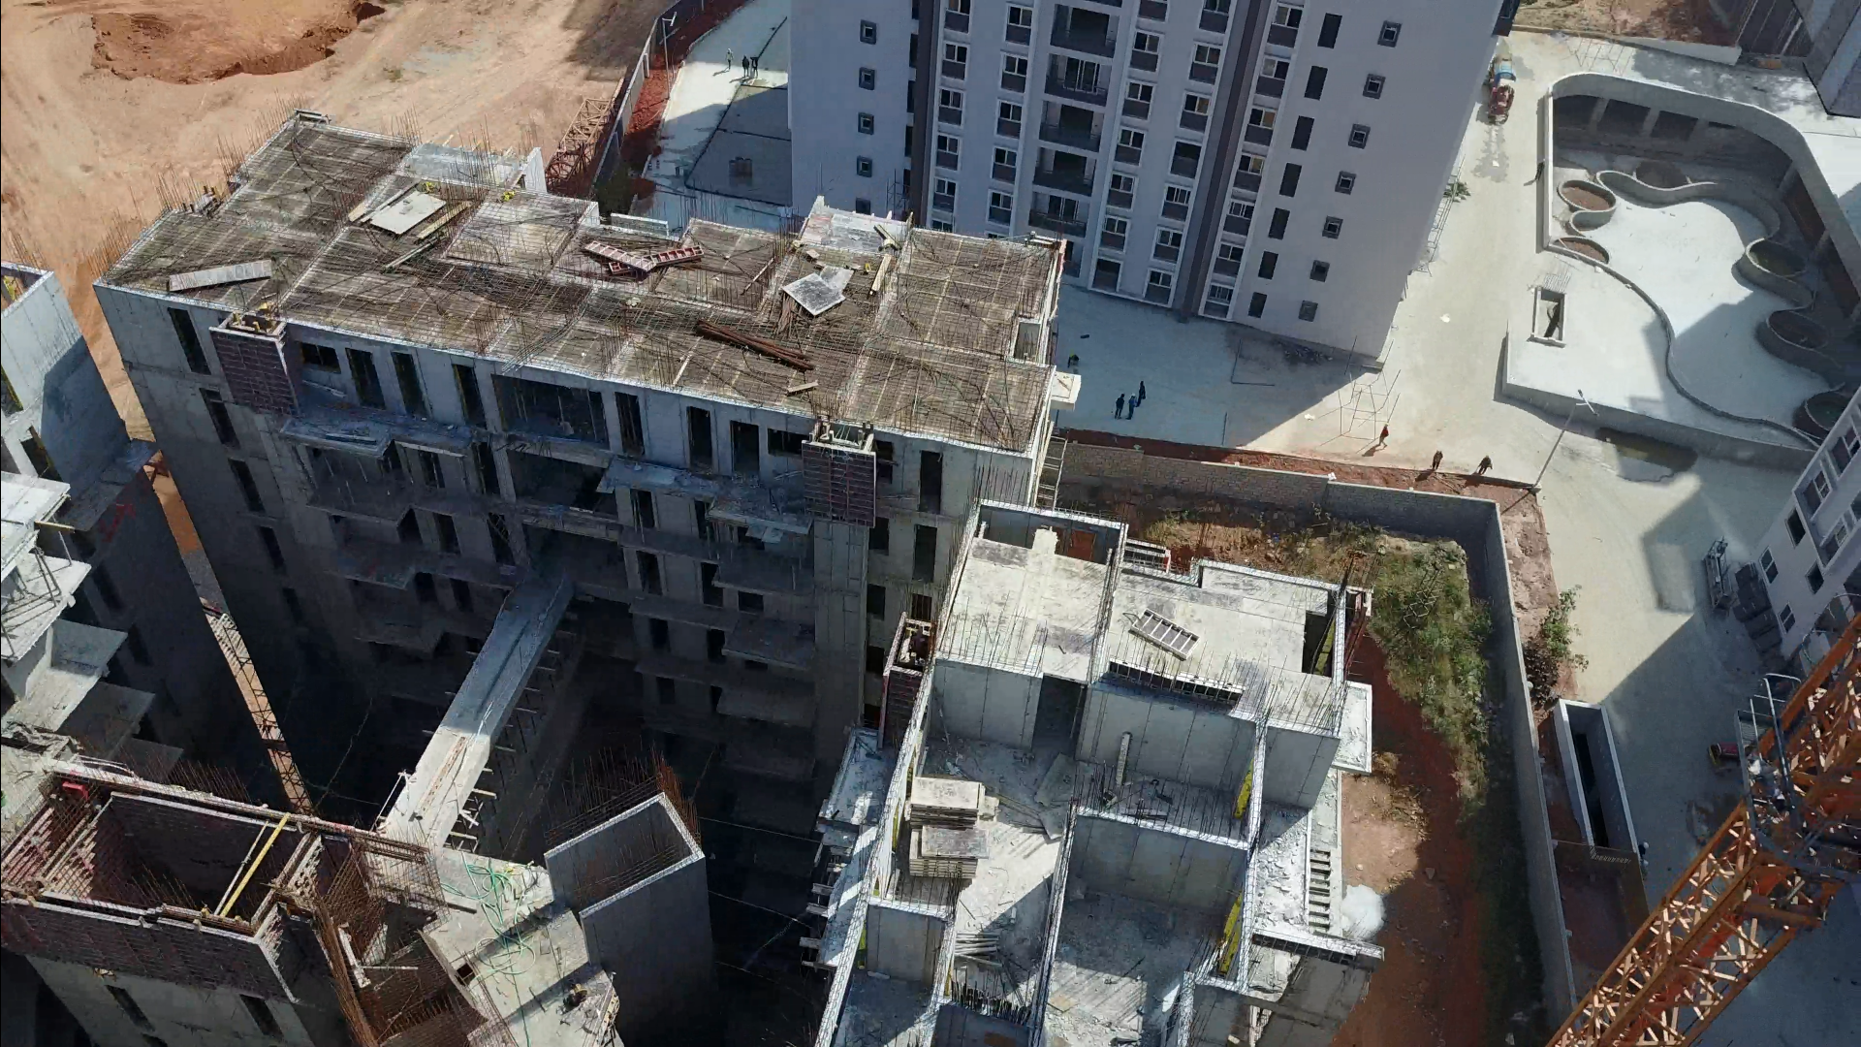
Slab form work – Top View

Slide 12
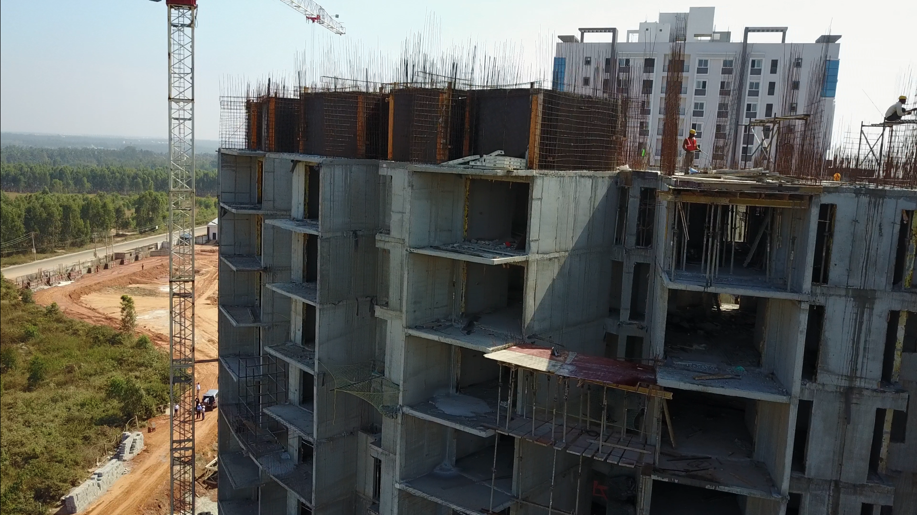
Wall form work –Internal side

Slide 13
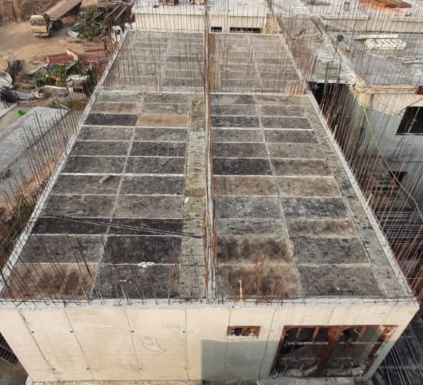
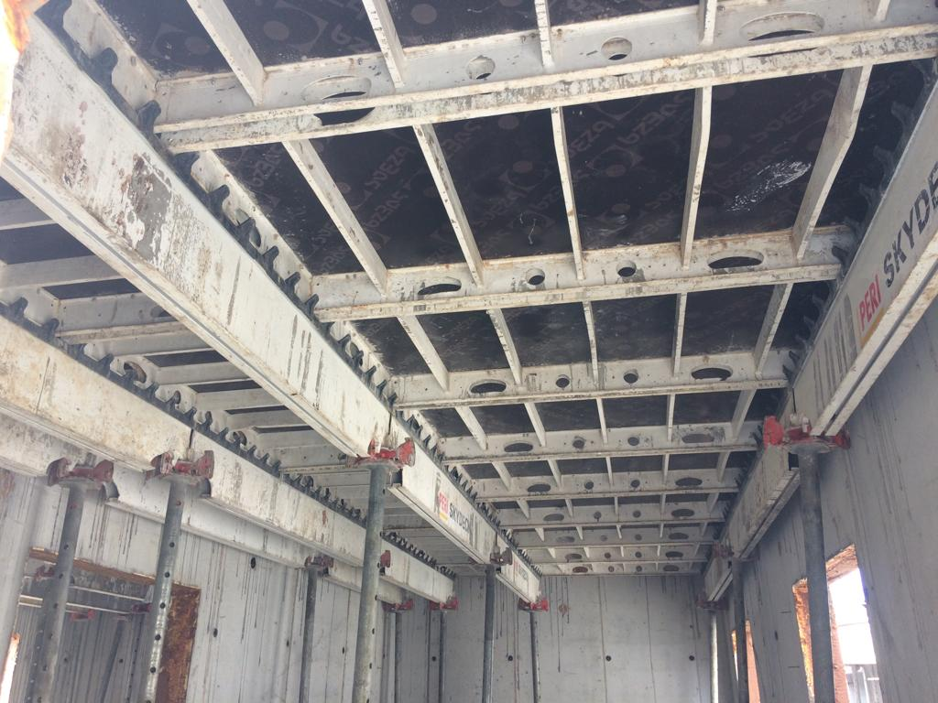
Slab form work –Crane Lifting

Slide 14
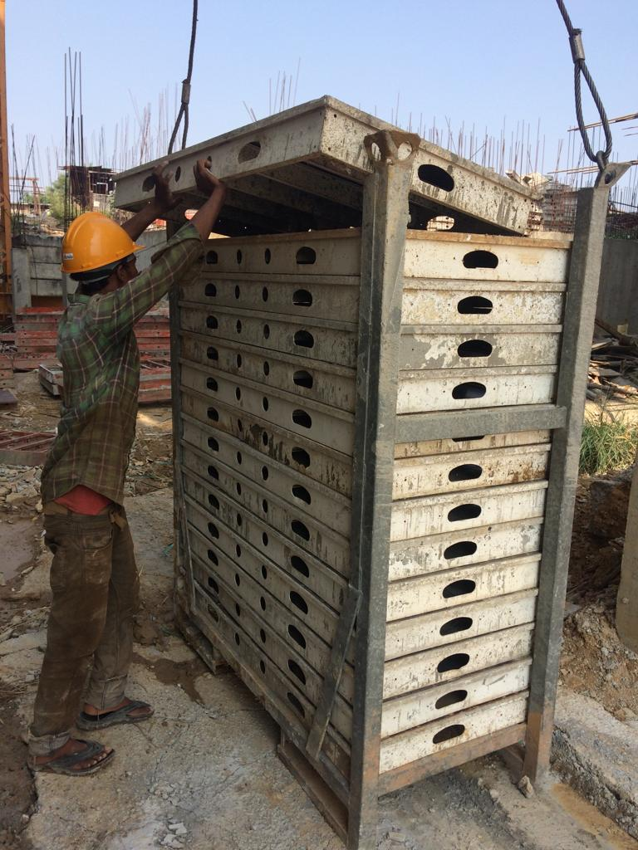
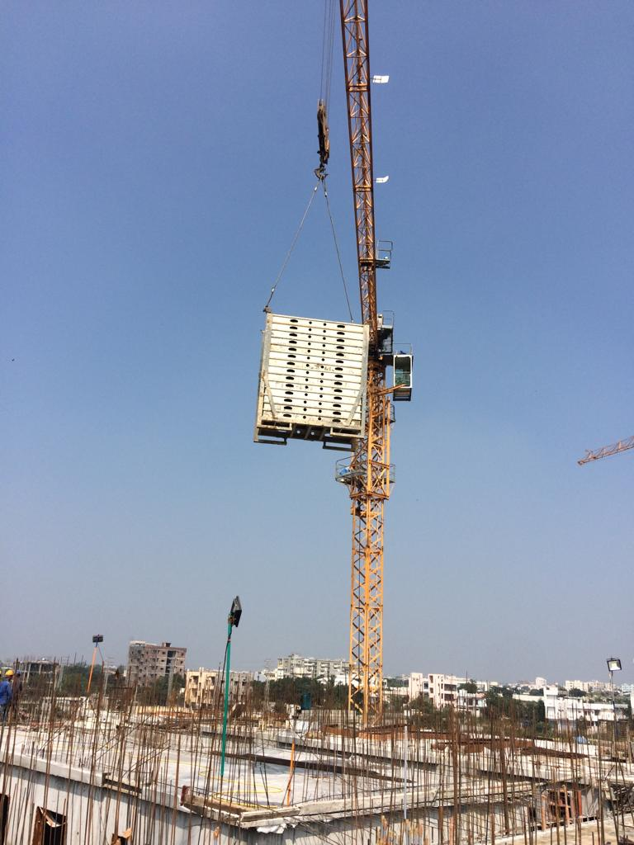
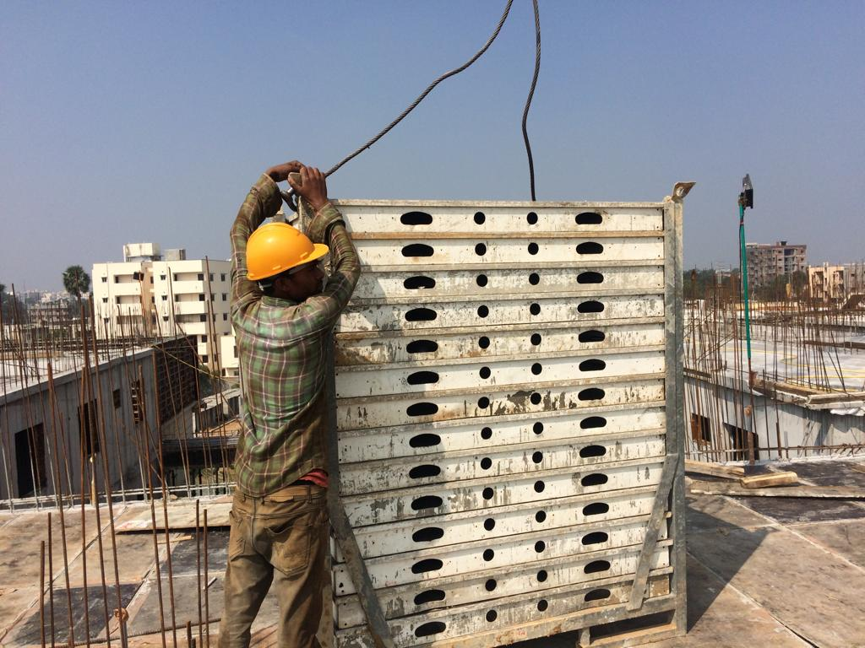
Slab form work –Crane Lifting

Slide 15
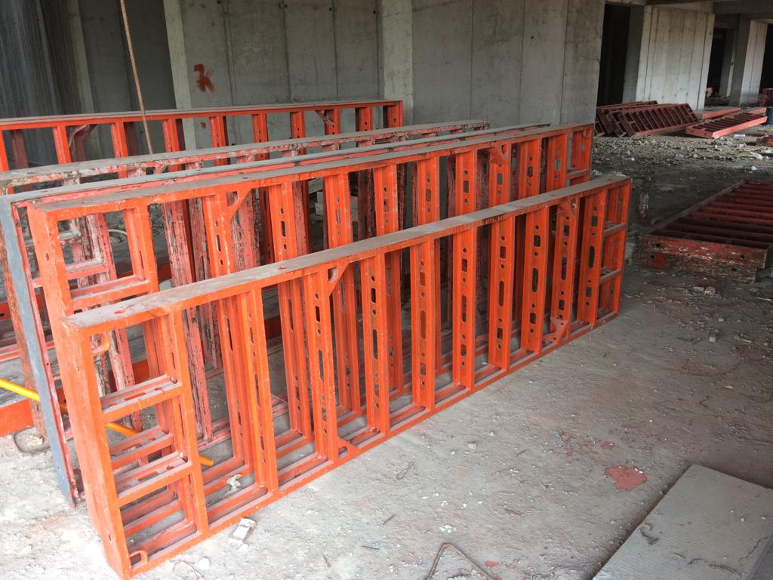
Wall form work –Refurbishing

Slide 16
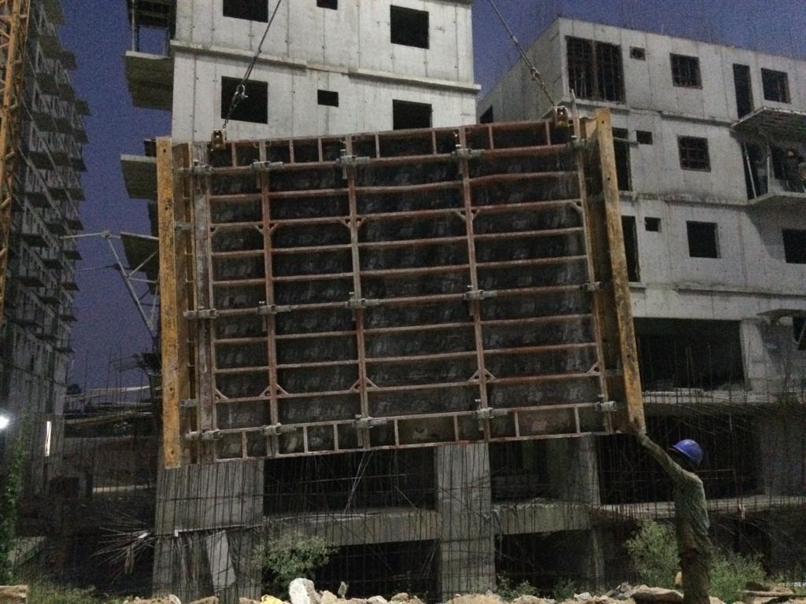
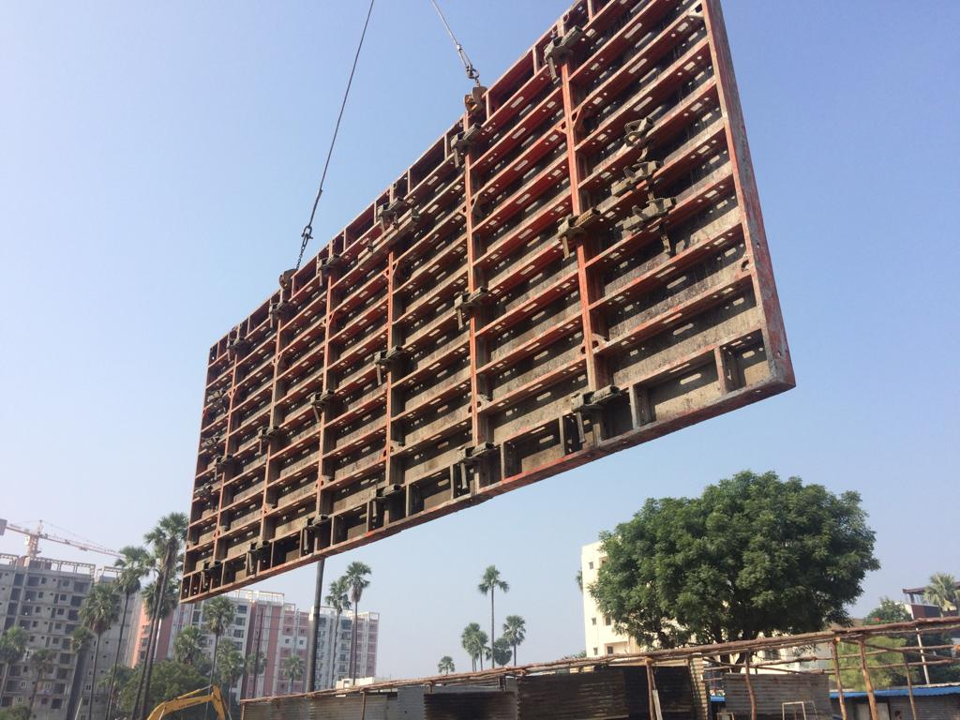
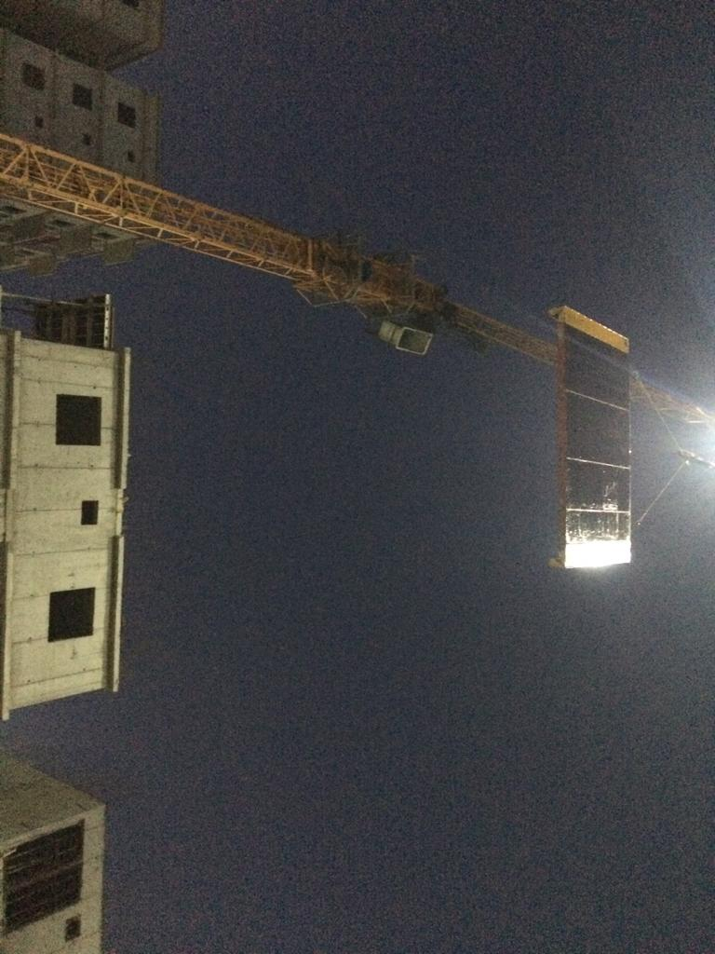
Wall form work –Crane Lifting

Slide 17
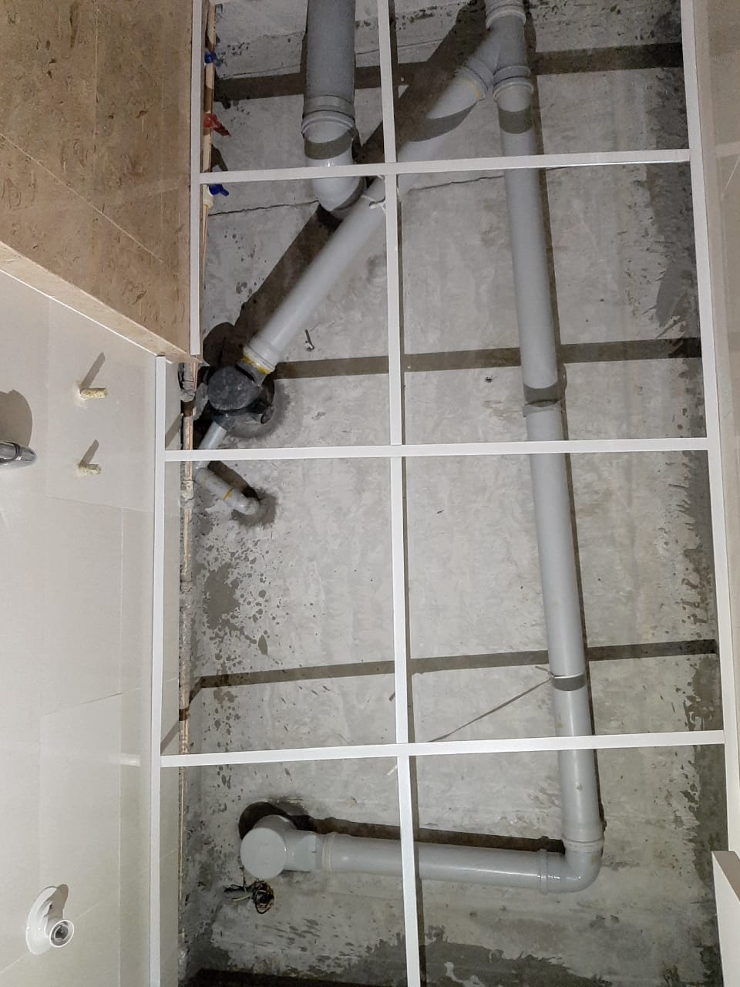
Drain pipes through bottom flat

Slide 18
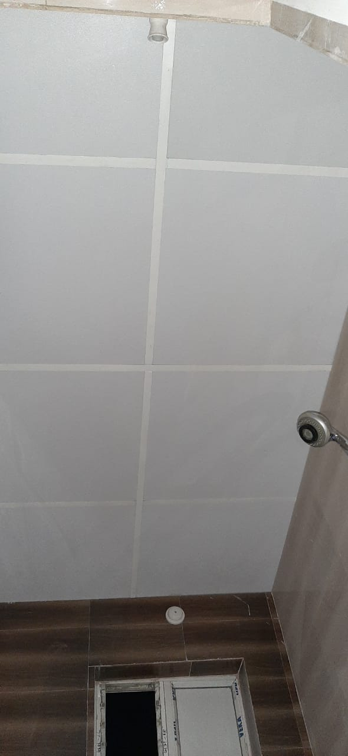
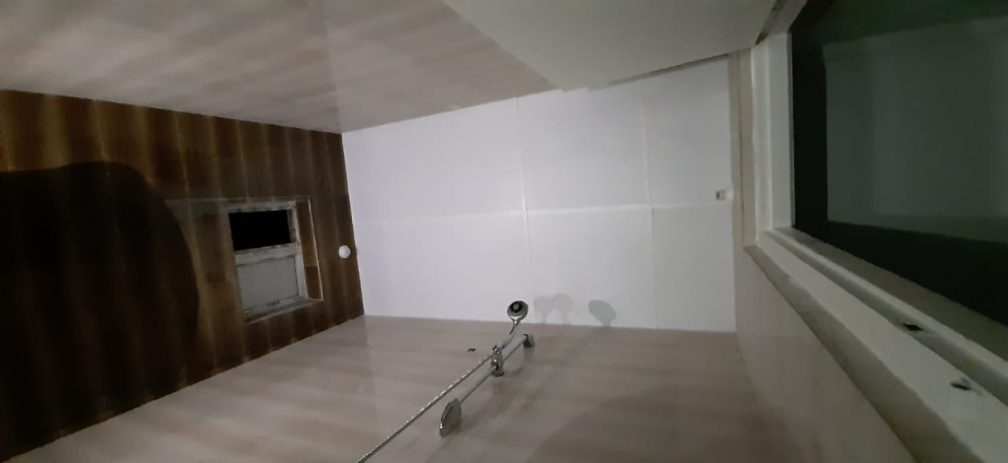
False Ceiling in Toilets

Slide 19
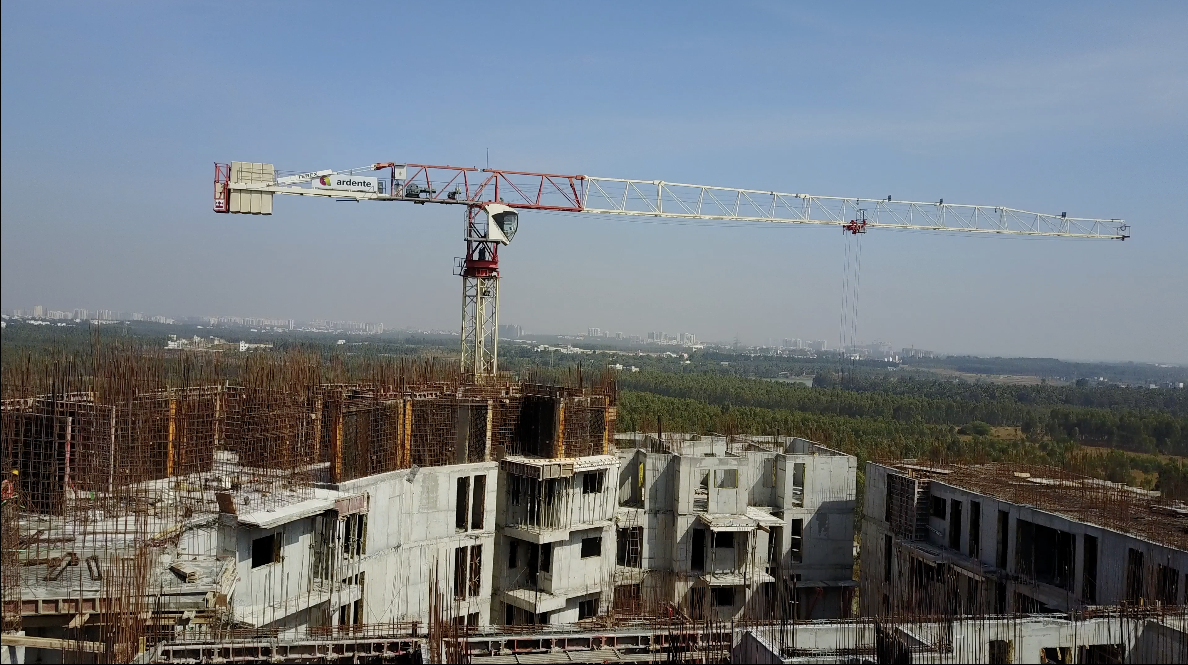
15 Floors Project Built using Modular Form Work

Slide 20
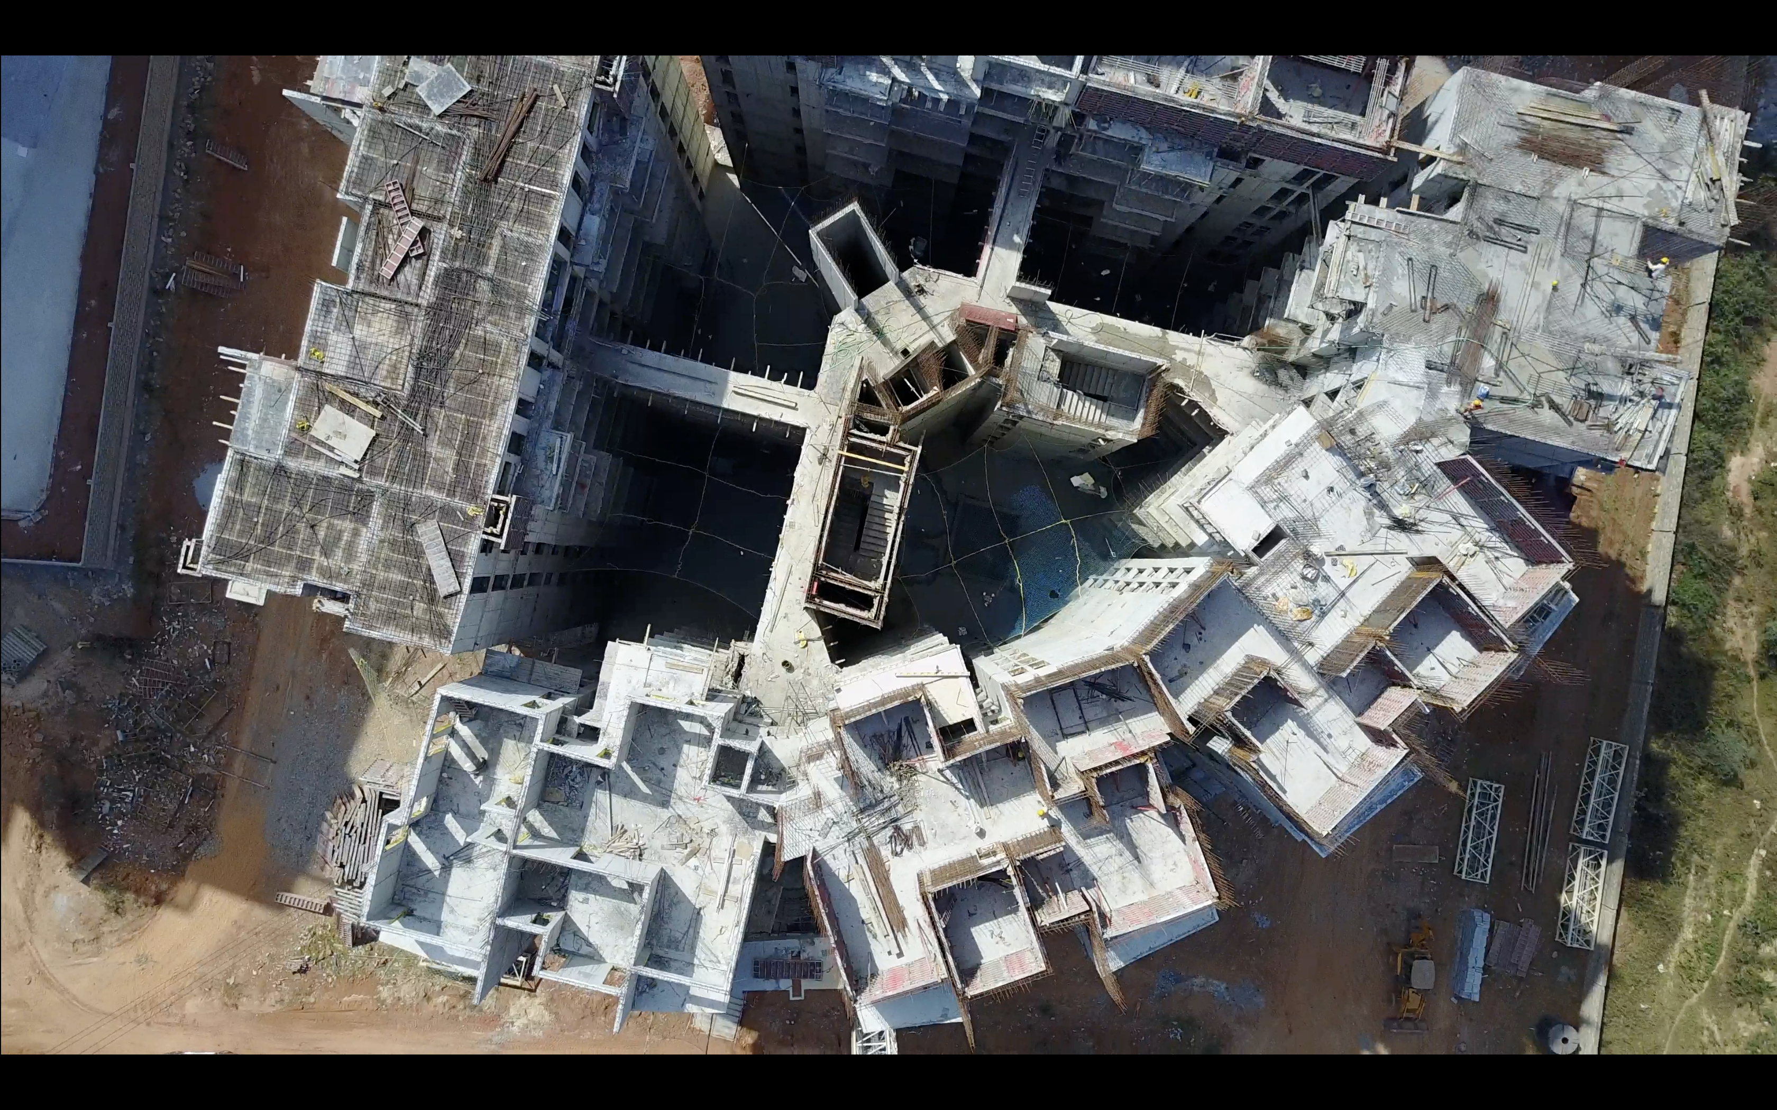
15 Floors Project Built using Modular Form Work

Slide 21
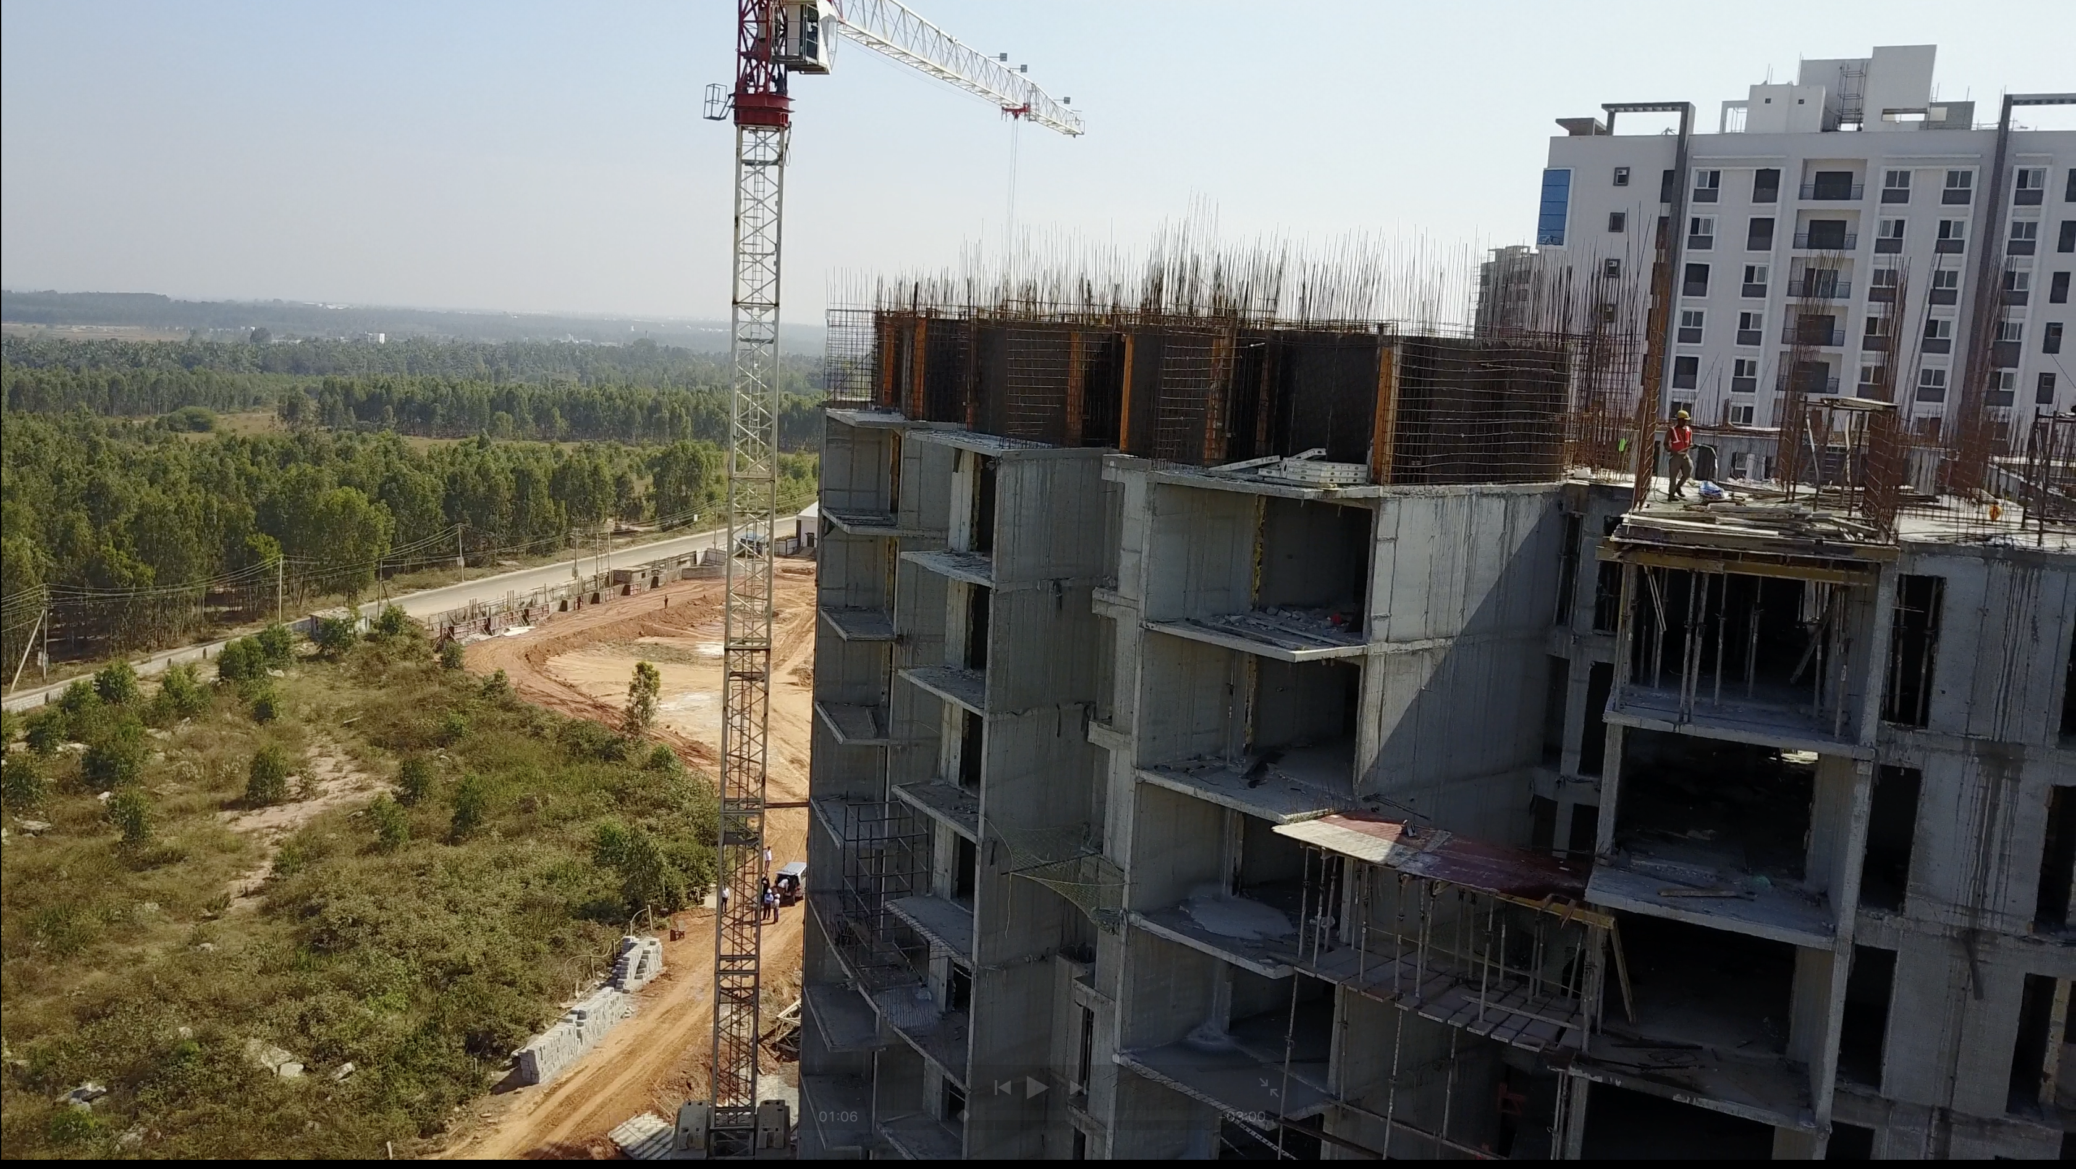
15 Floors Project Built using Modular Form Work

Slide 22
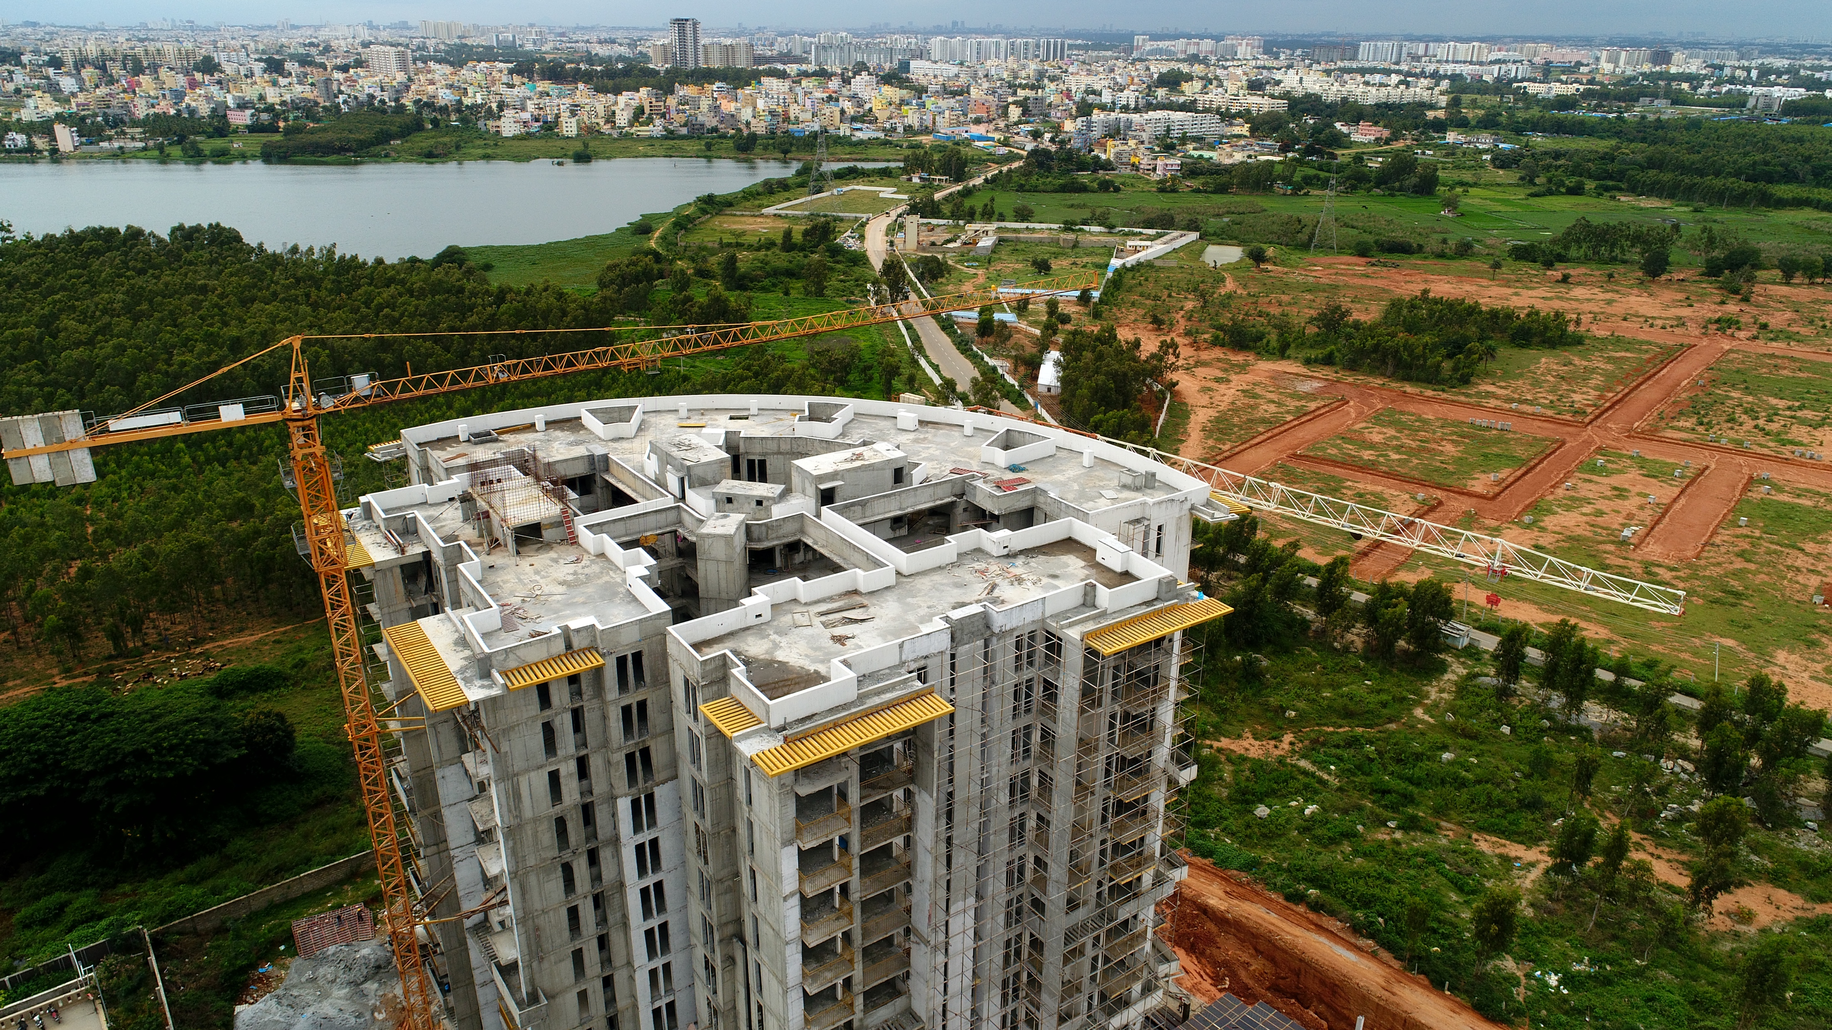
Pine grove - Under finishes

Slide 23
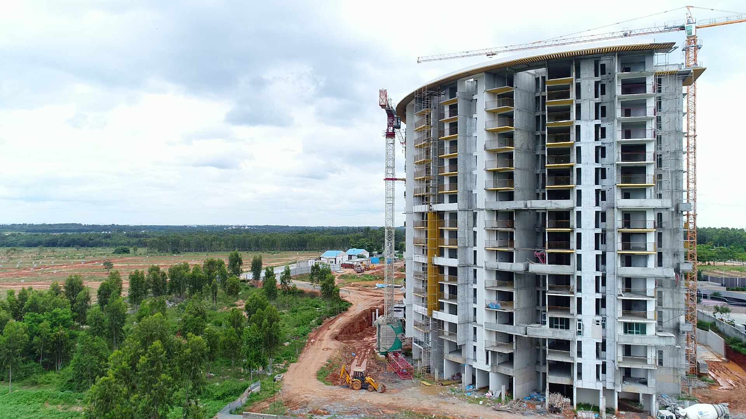
Pinegrove - Under Finishes

Slide 24
Precast Technology

Slide 25
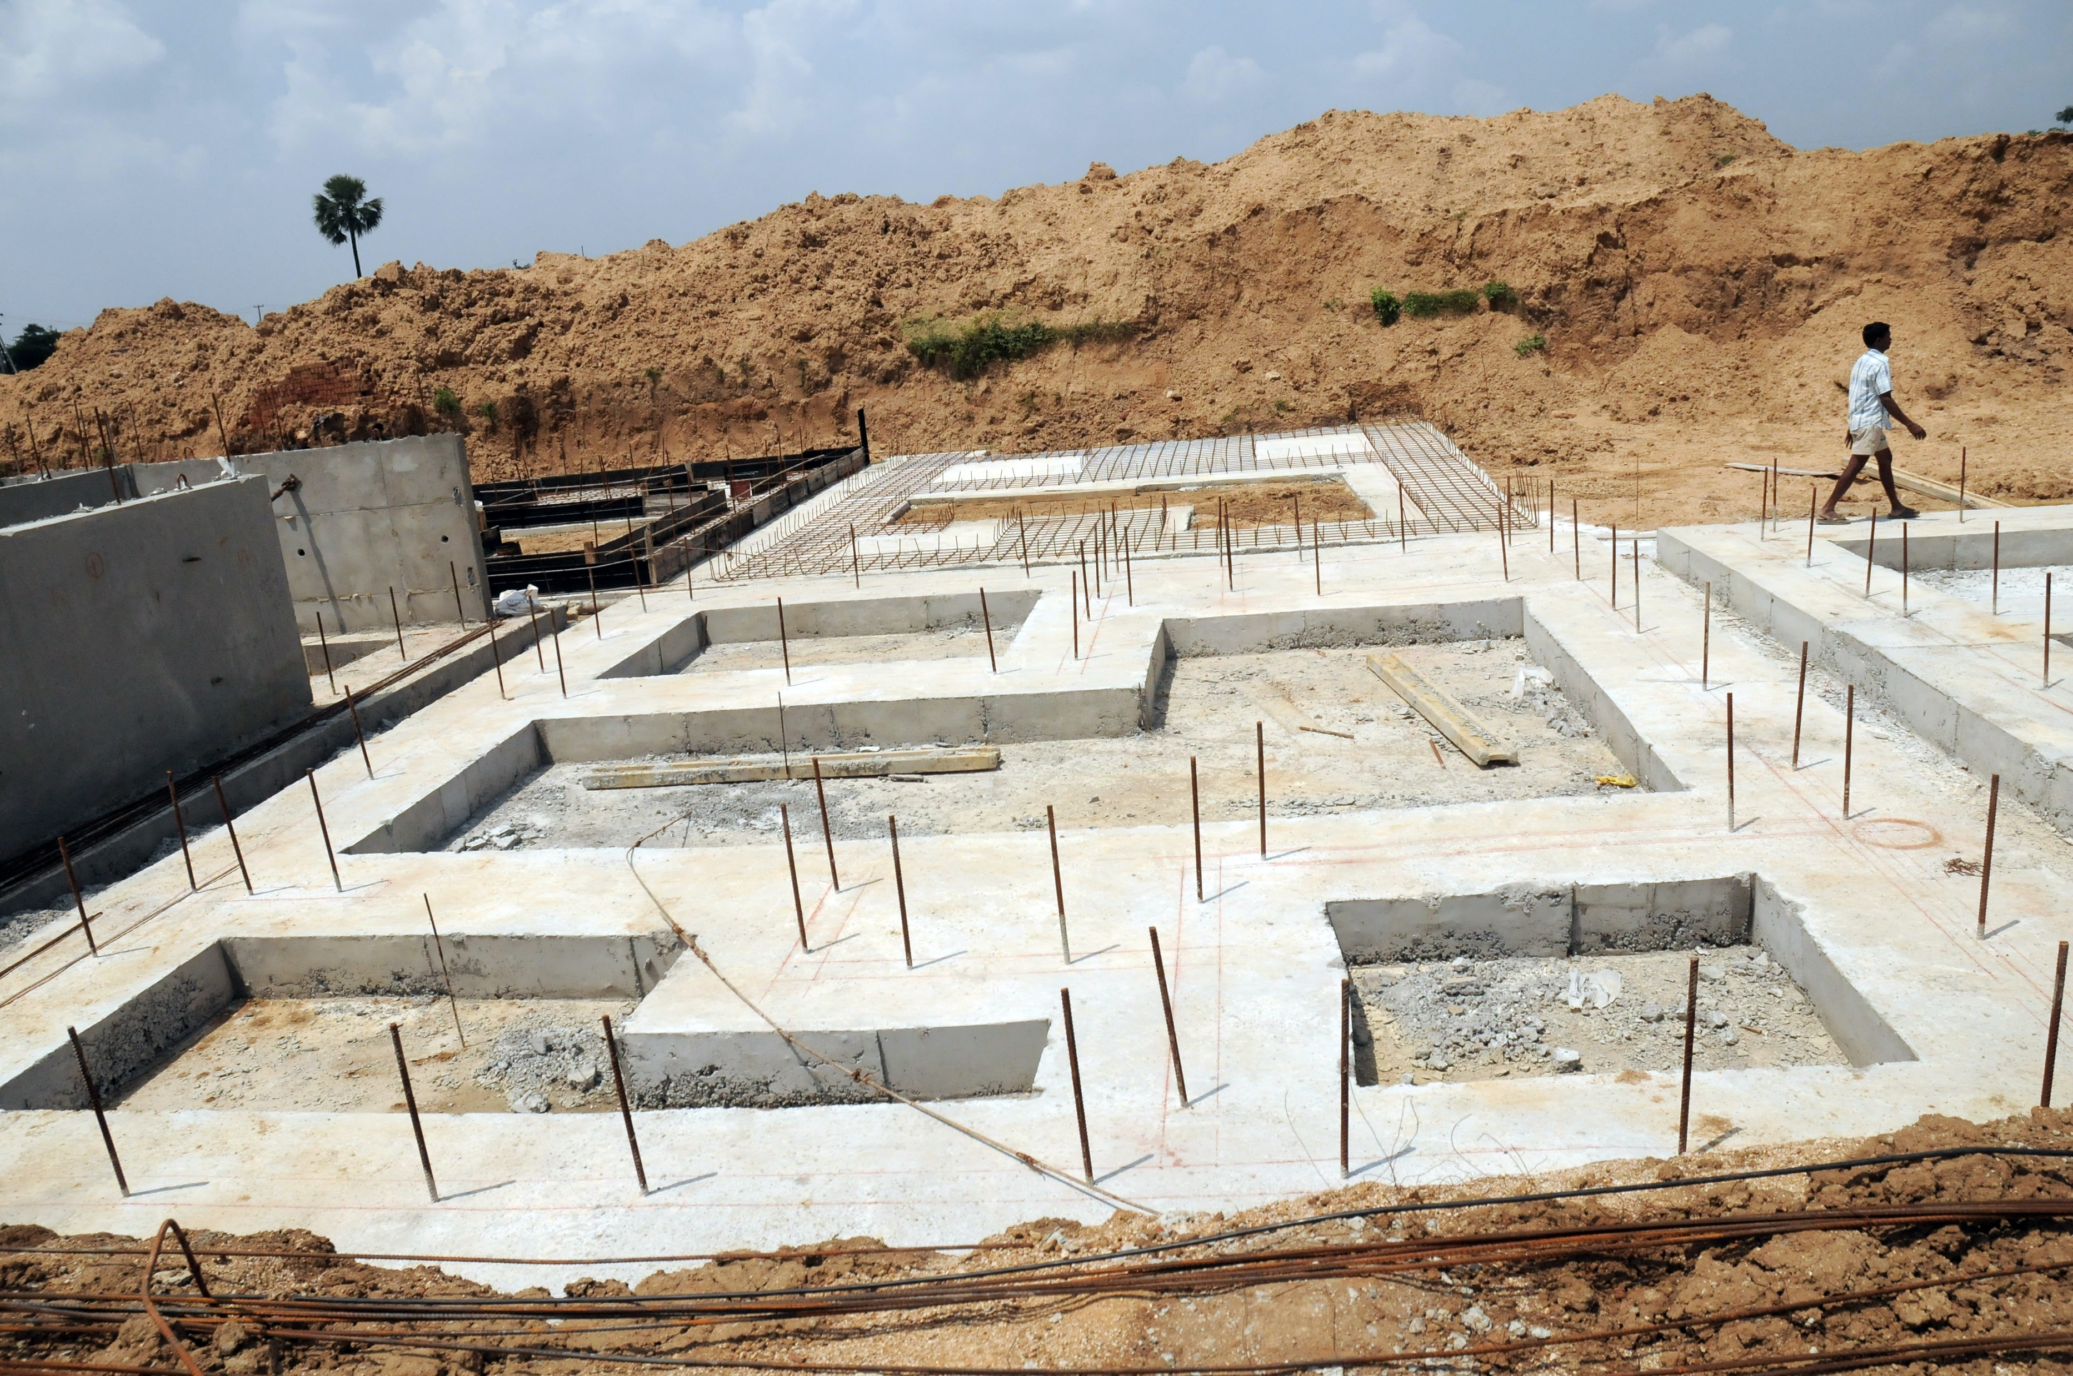
Case Study Villas
Day 1 to 3 Excavation, PCC & Subbase preparation

Slide 26
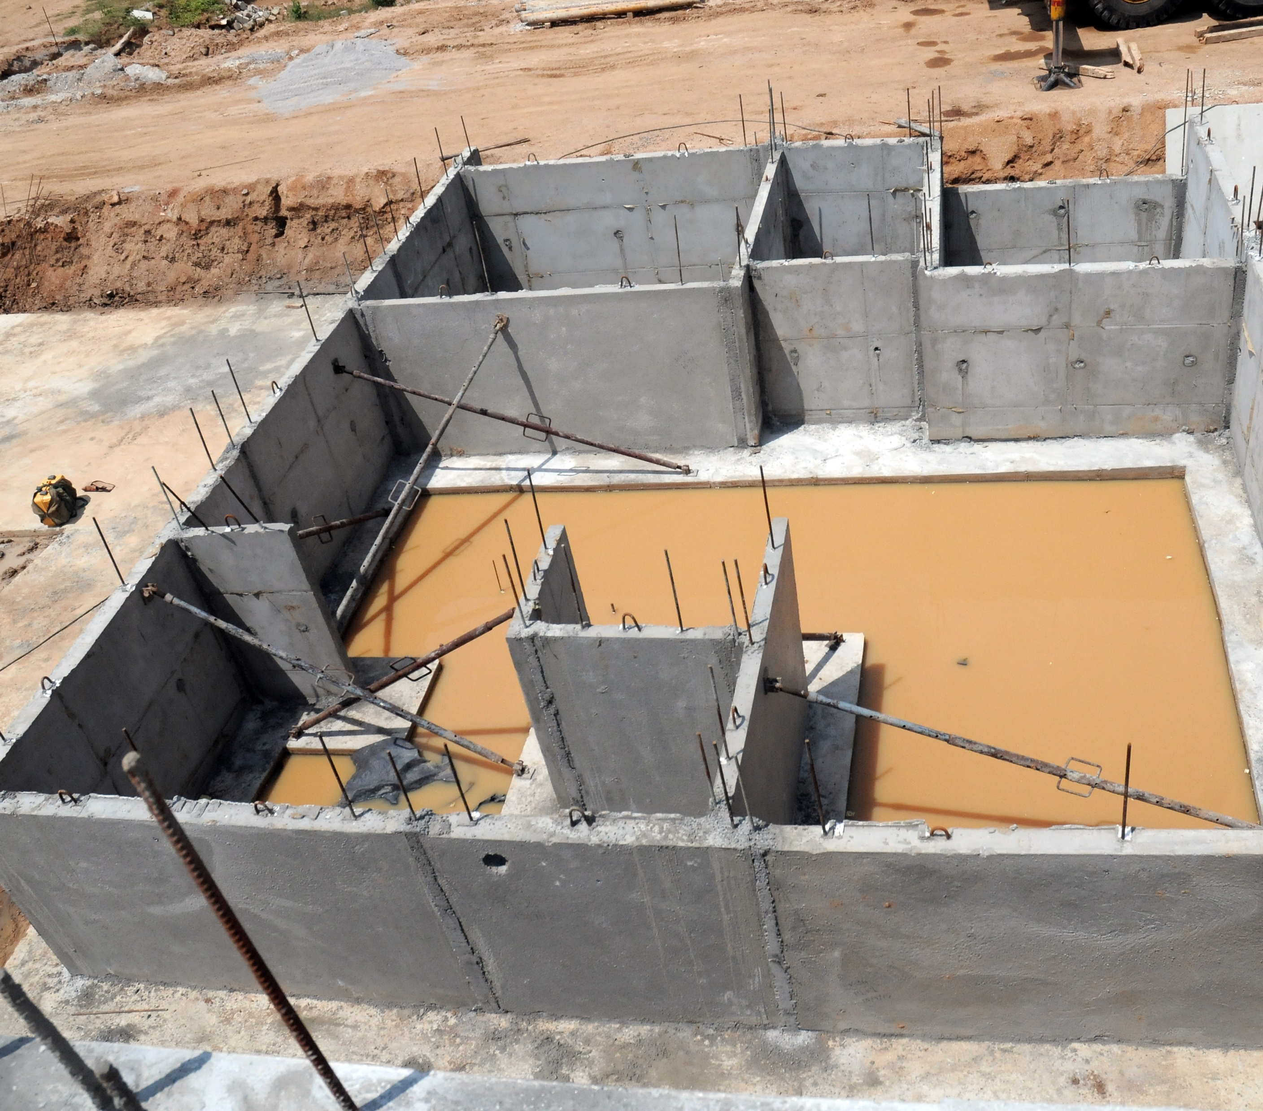
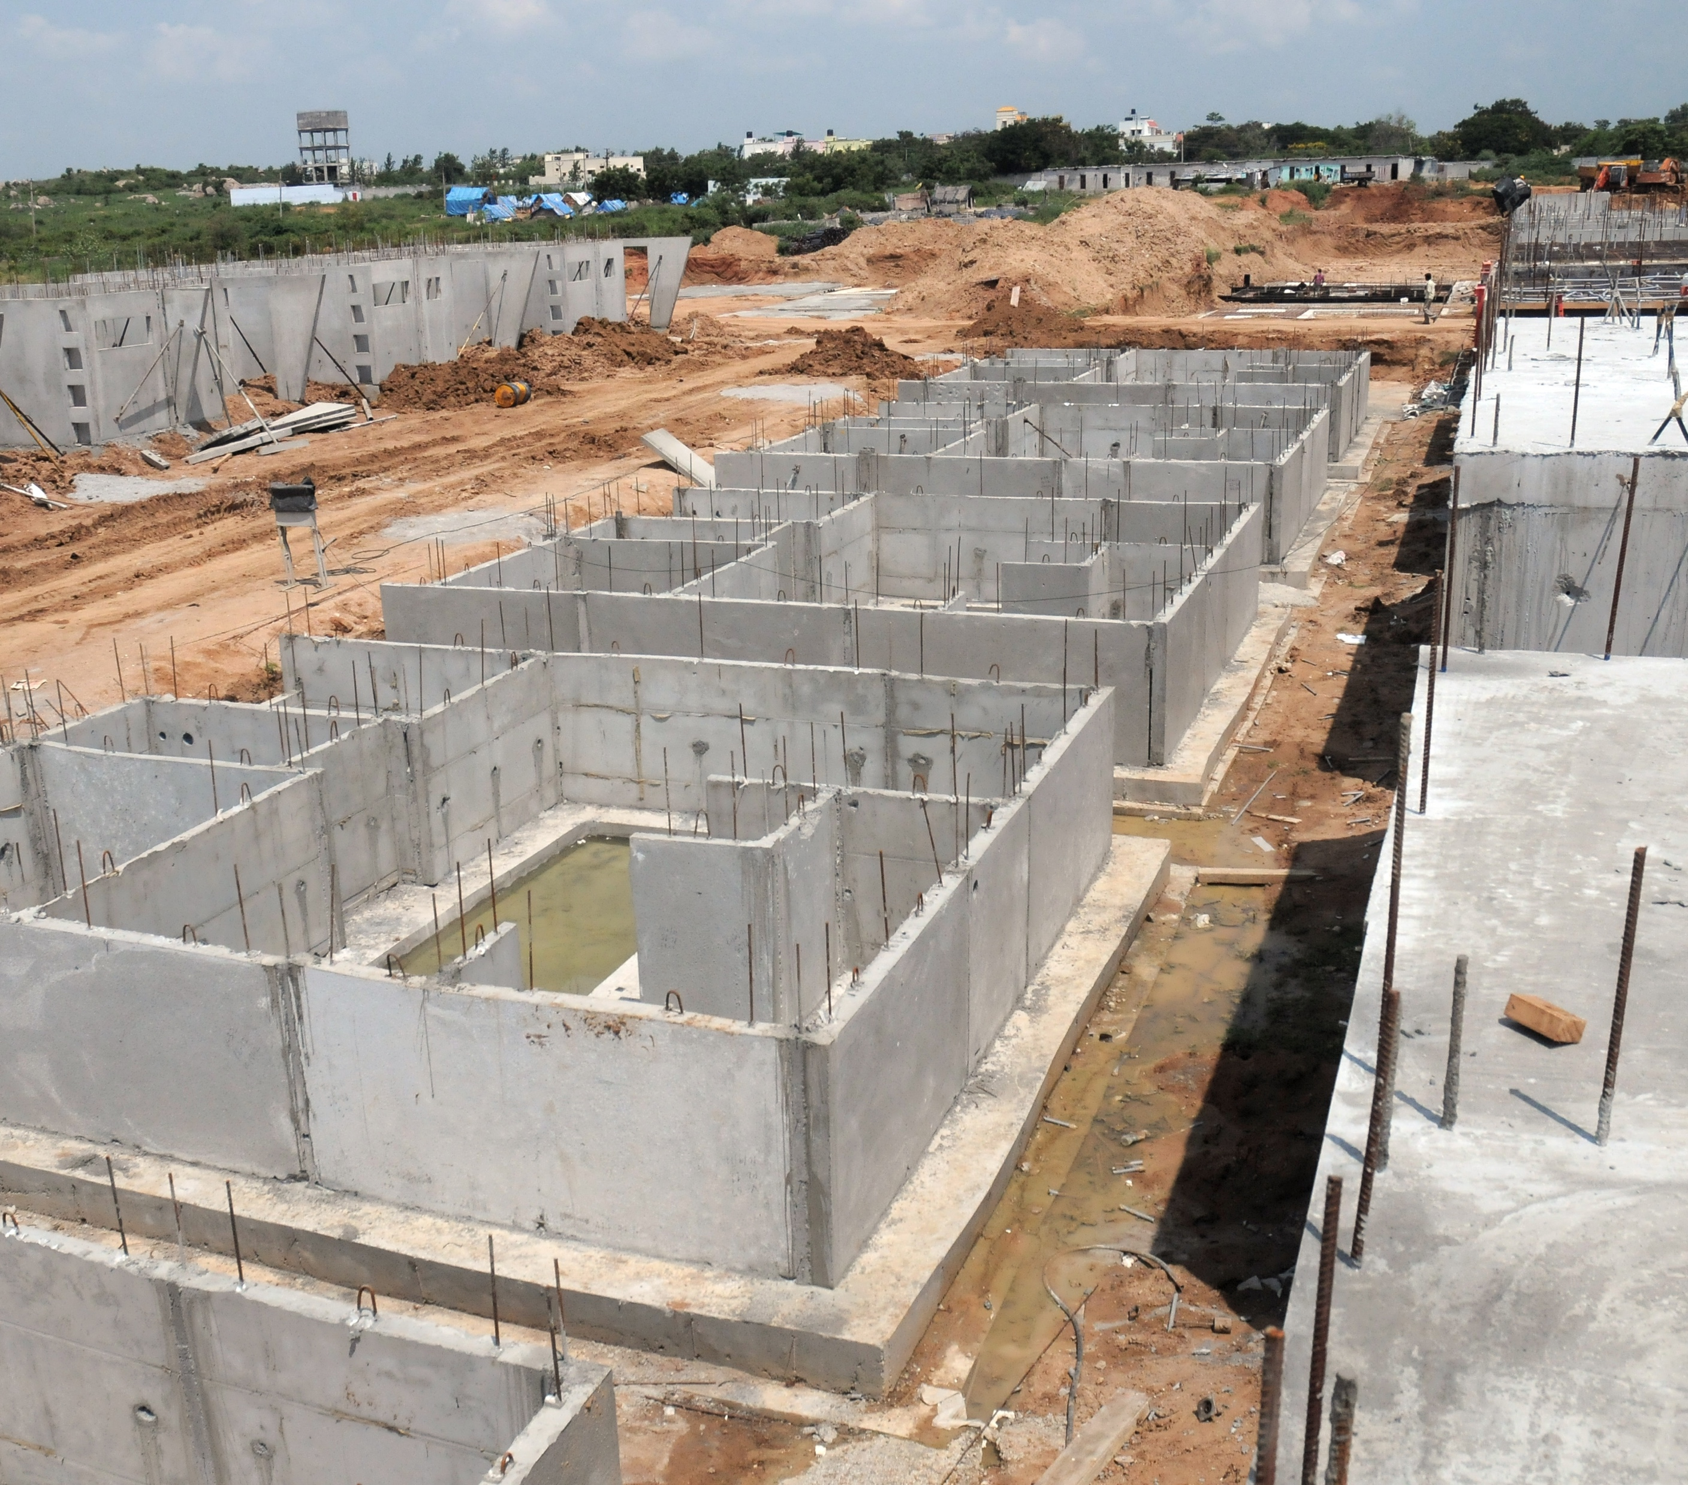
Case Study Villas
Day 4 to 7 Foundation Walls & Backfilling

Slide 27
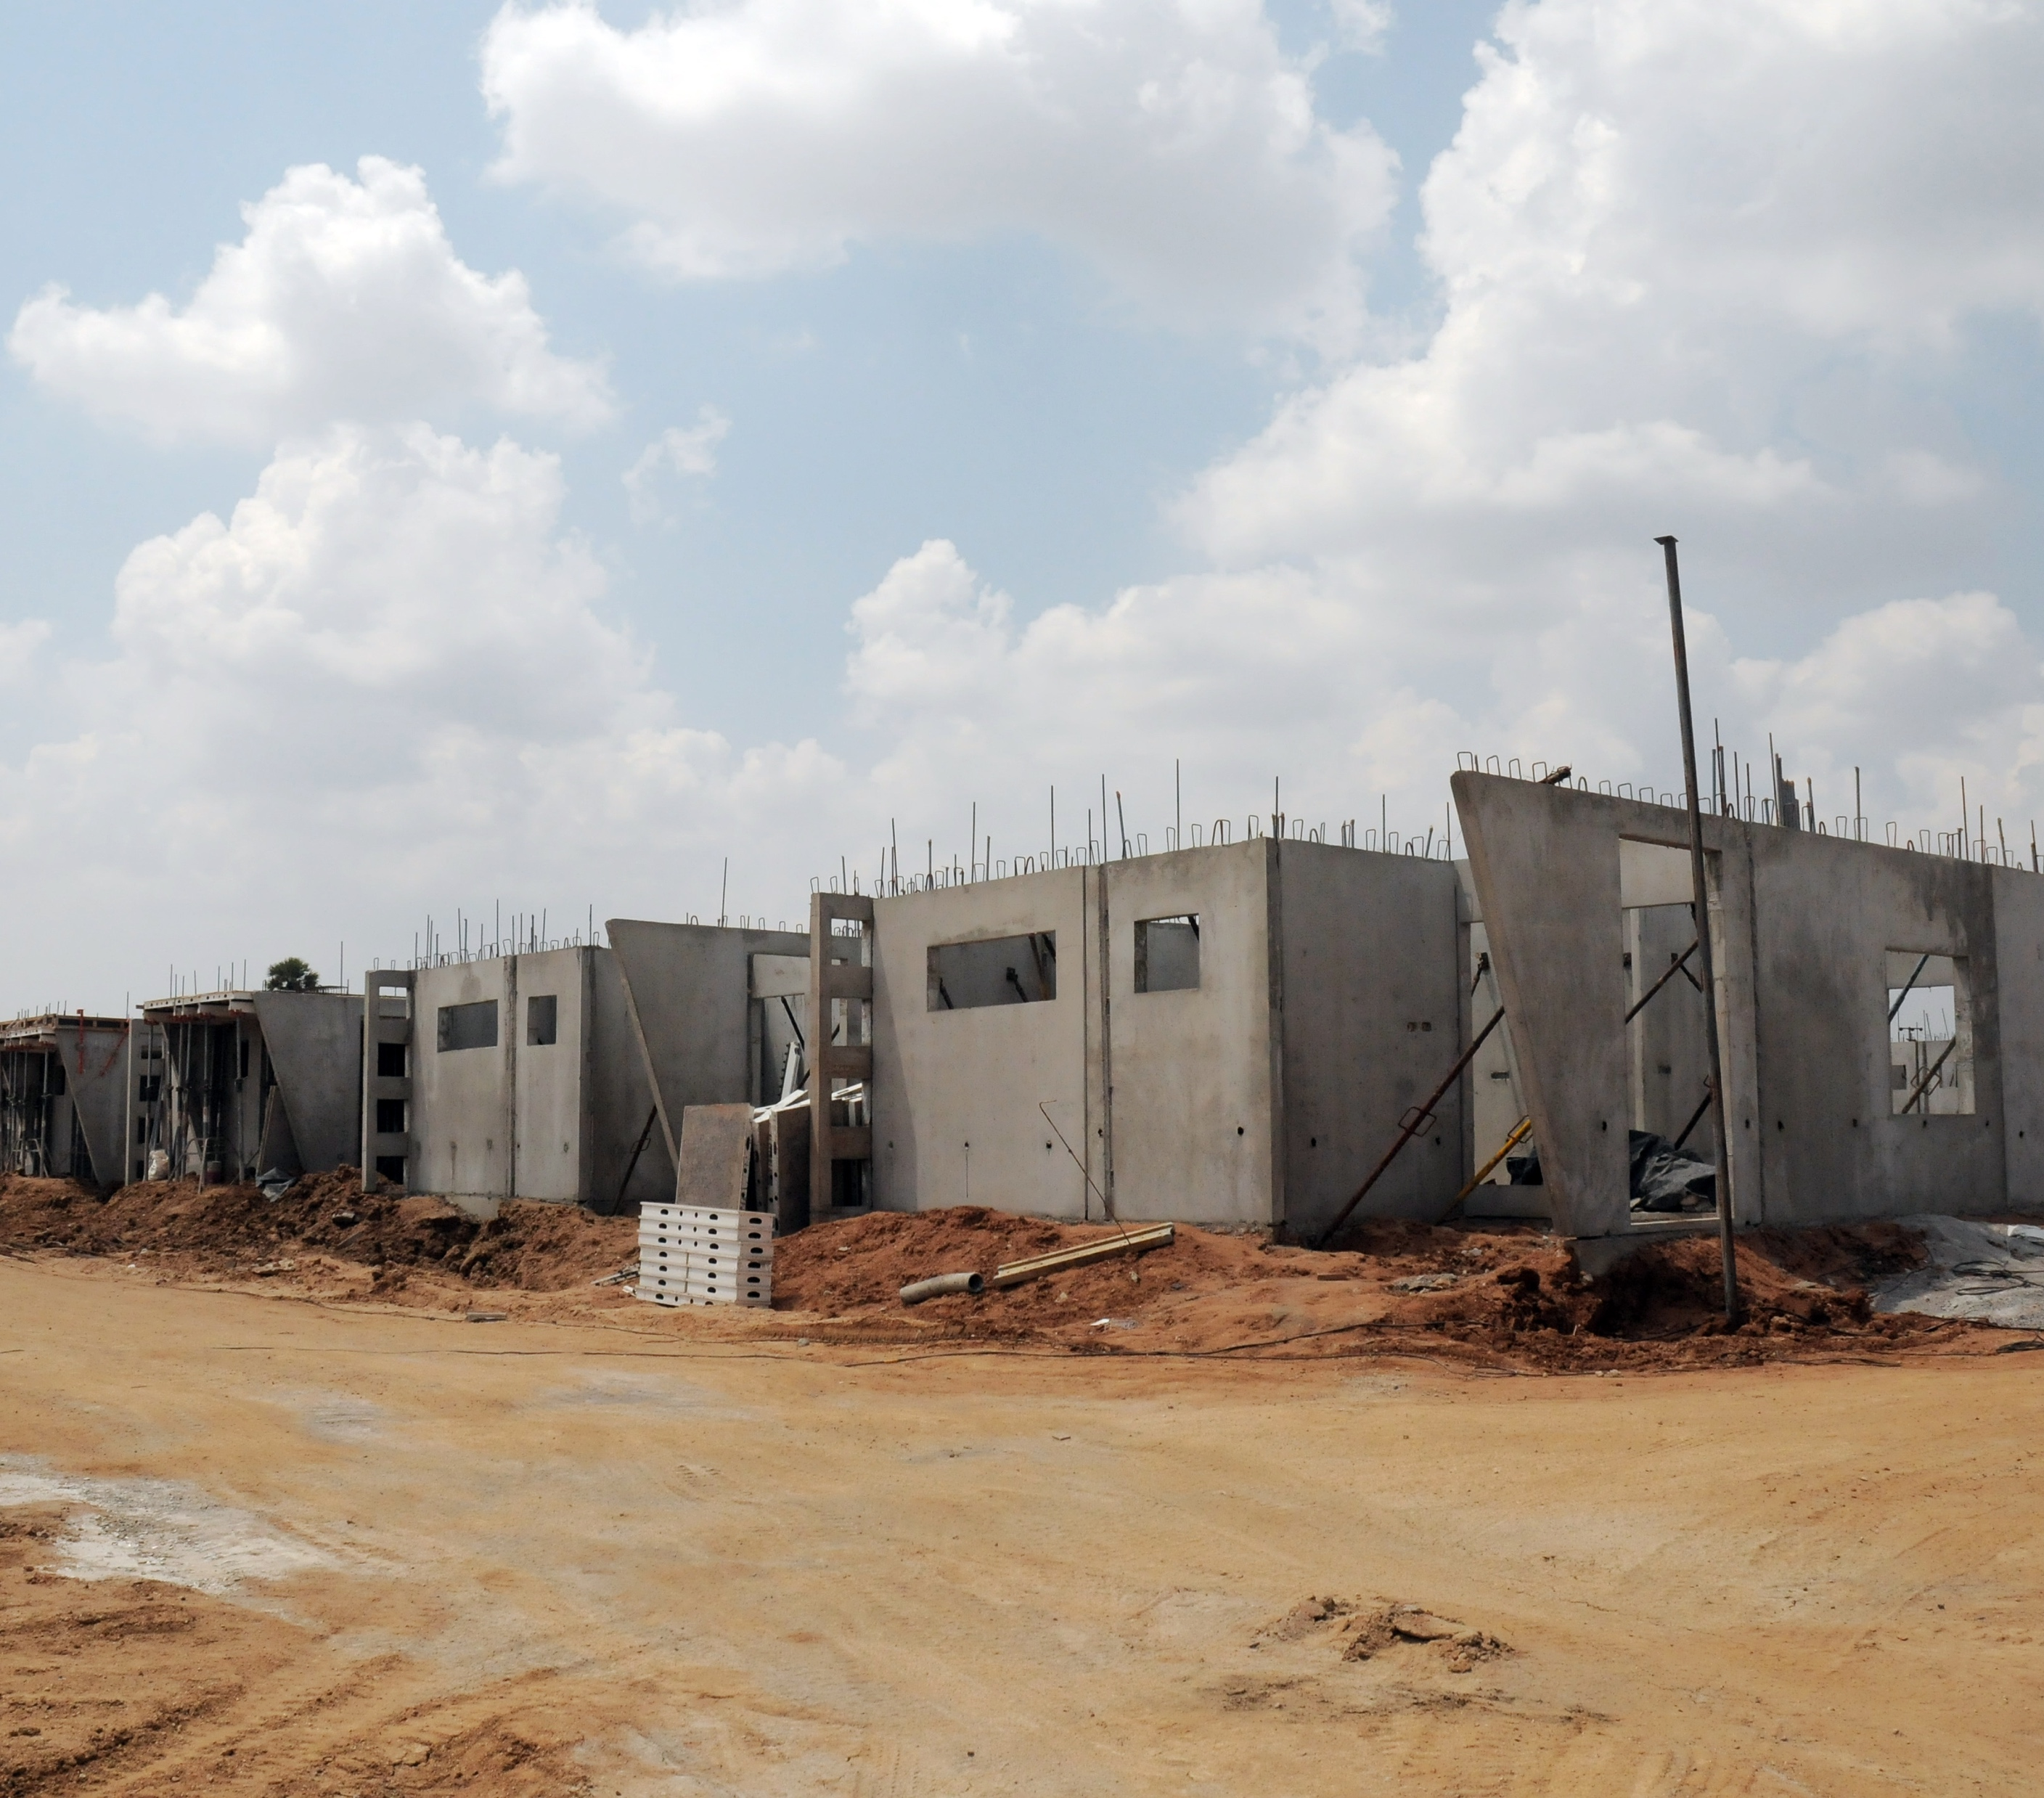
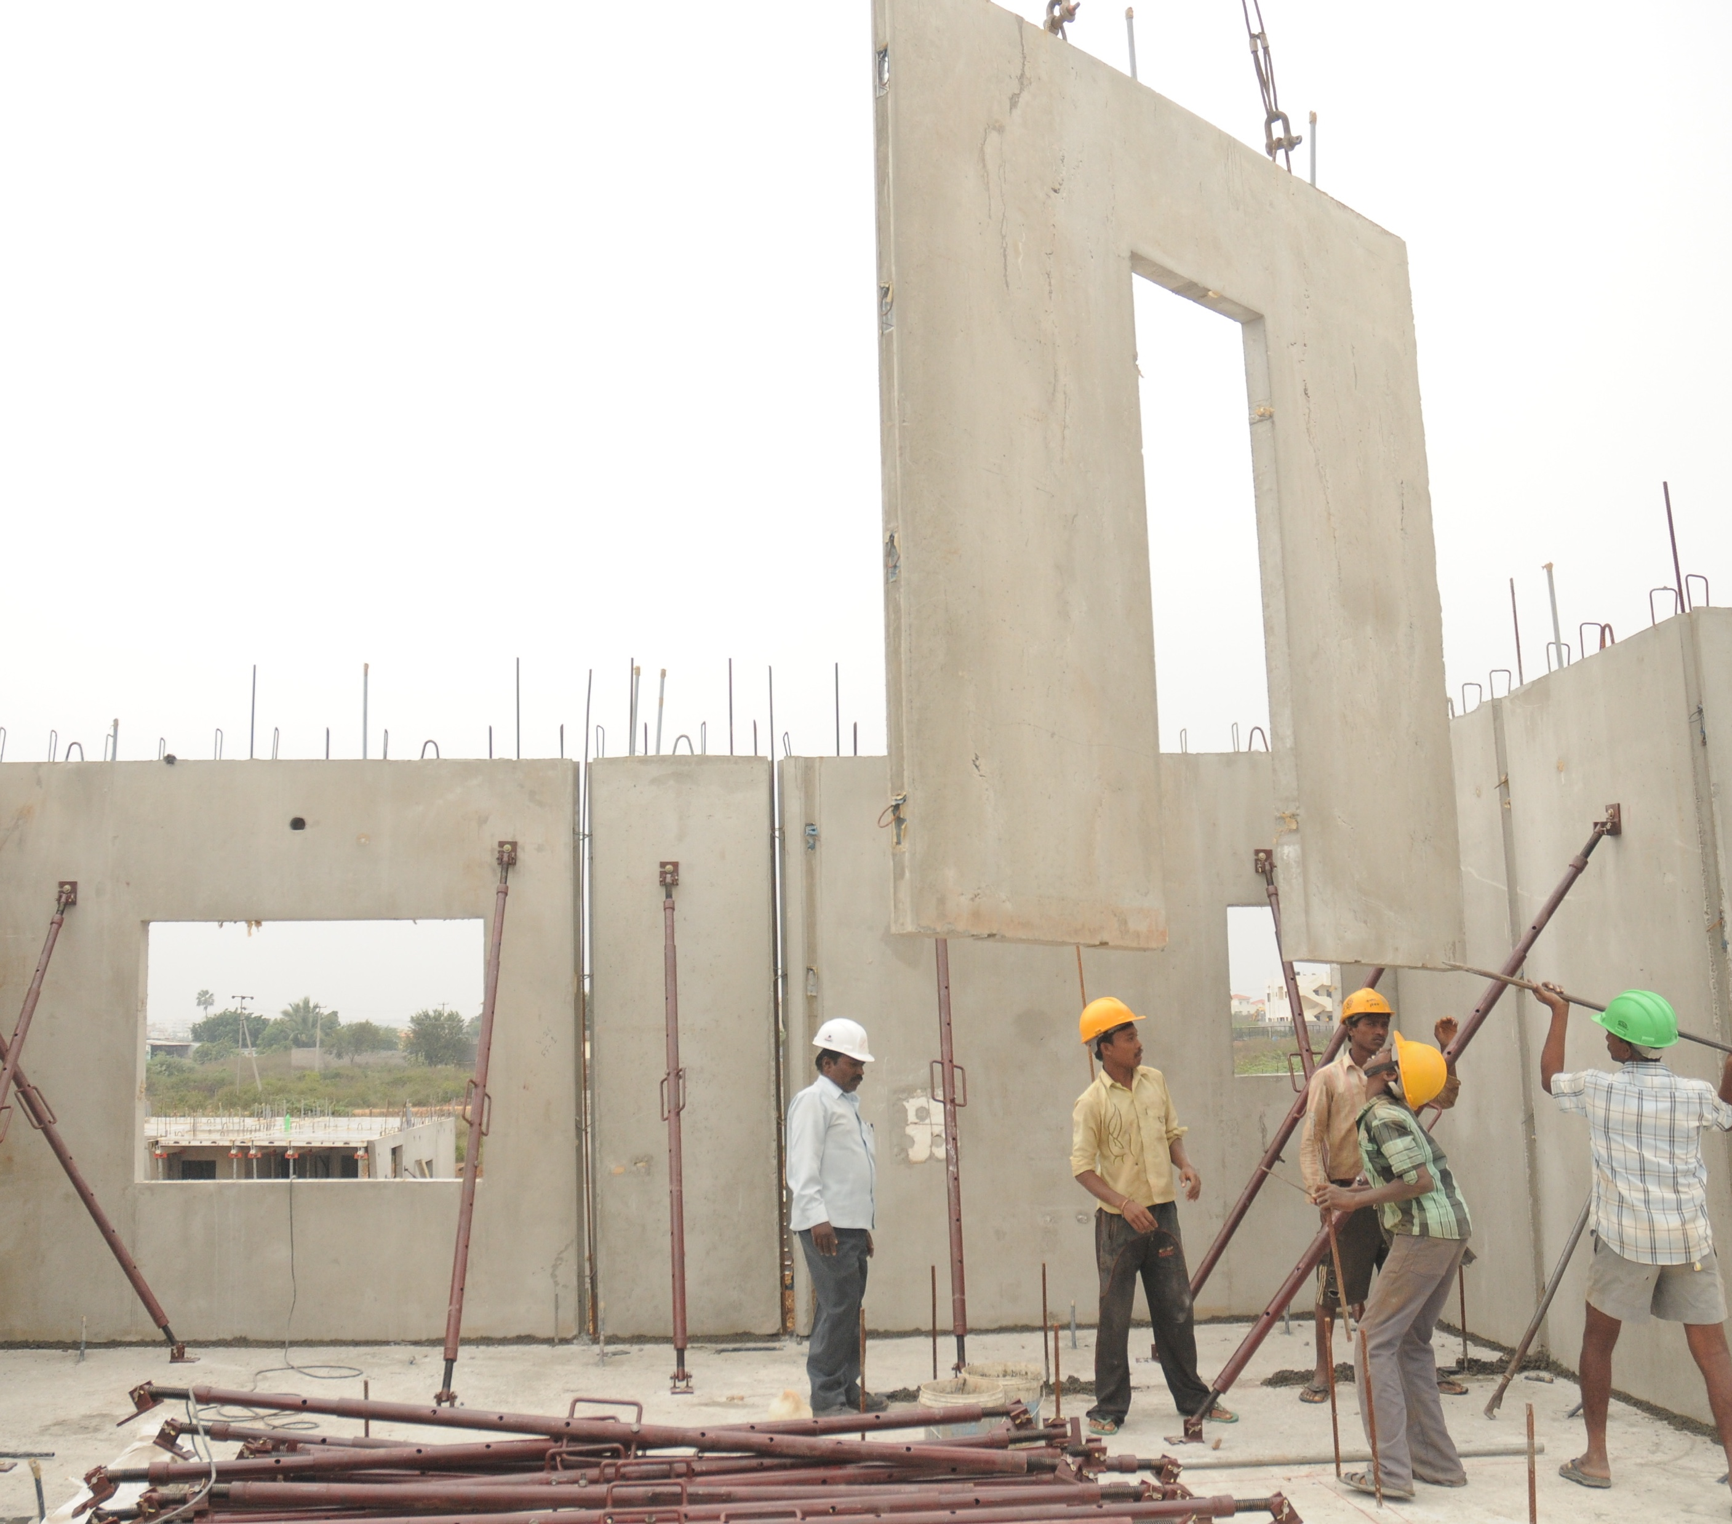
Case Study Villas
Day 8 Ground Floor Walls

Slide 28
Case Study Villas
Day 8 Ground Floor Walls

Slide 29
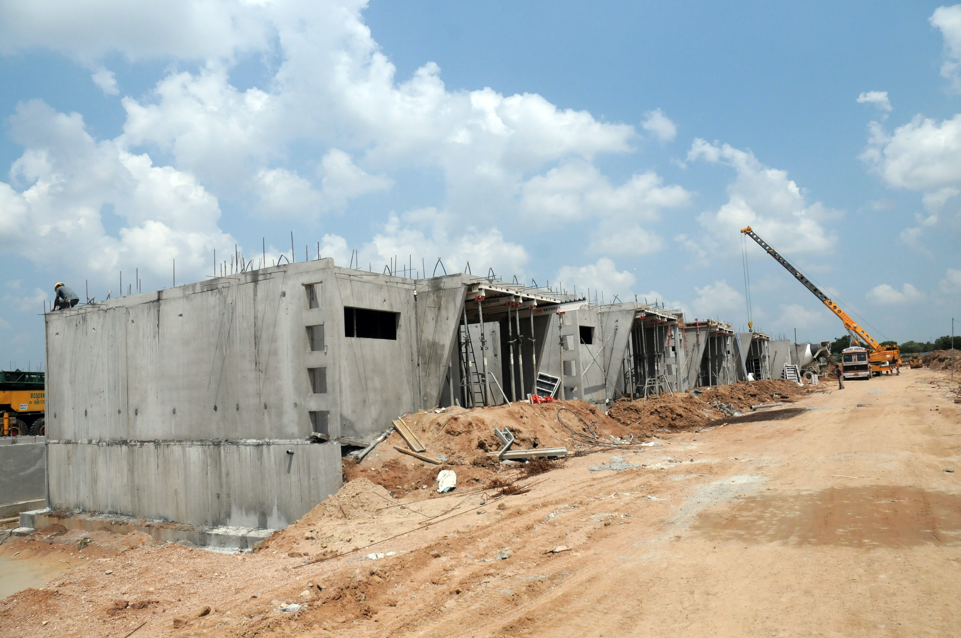
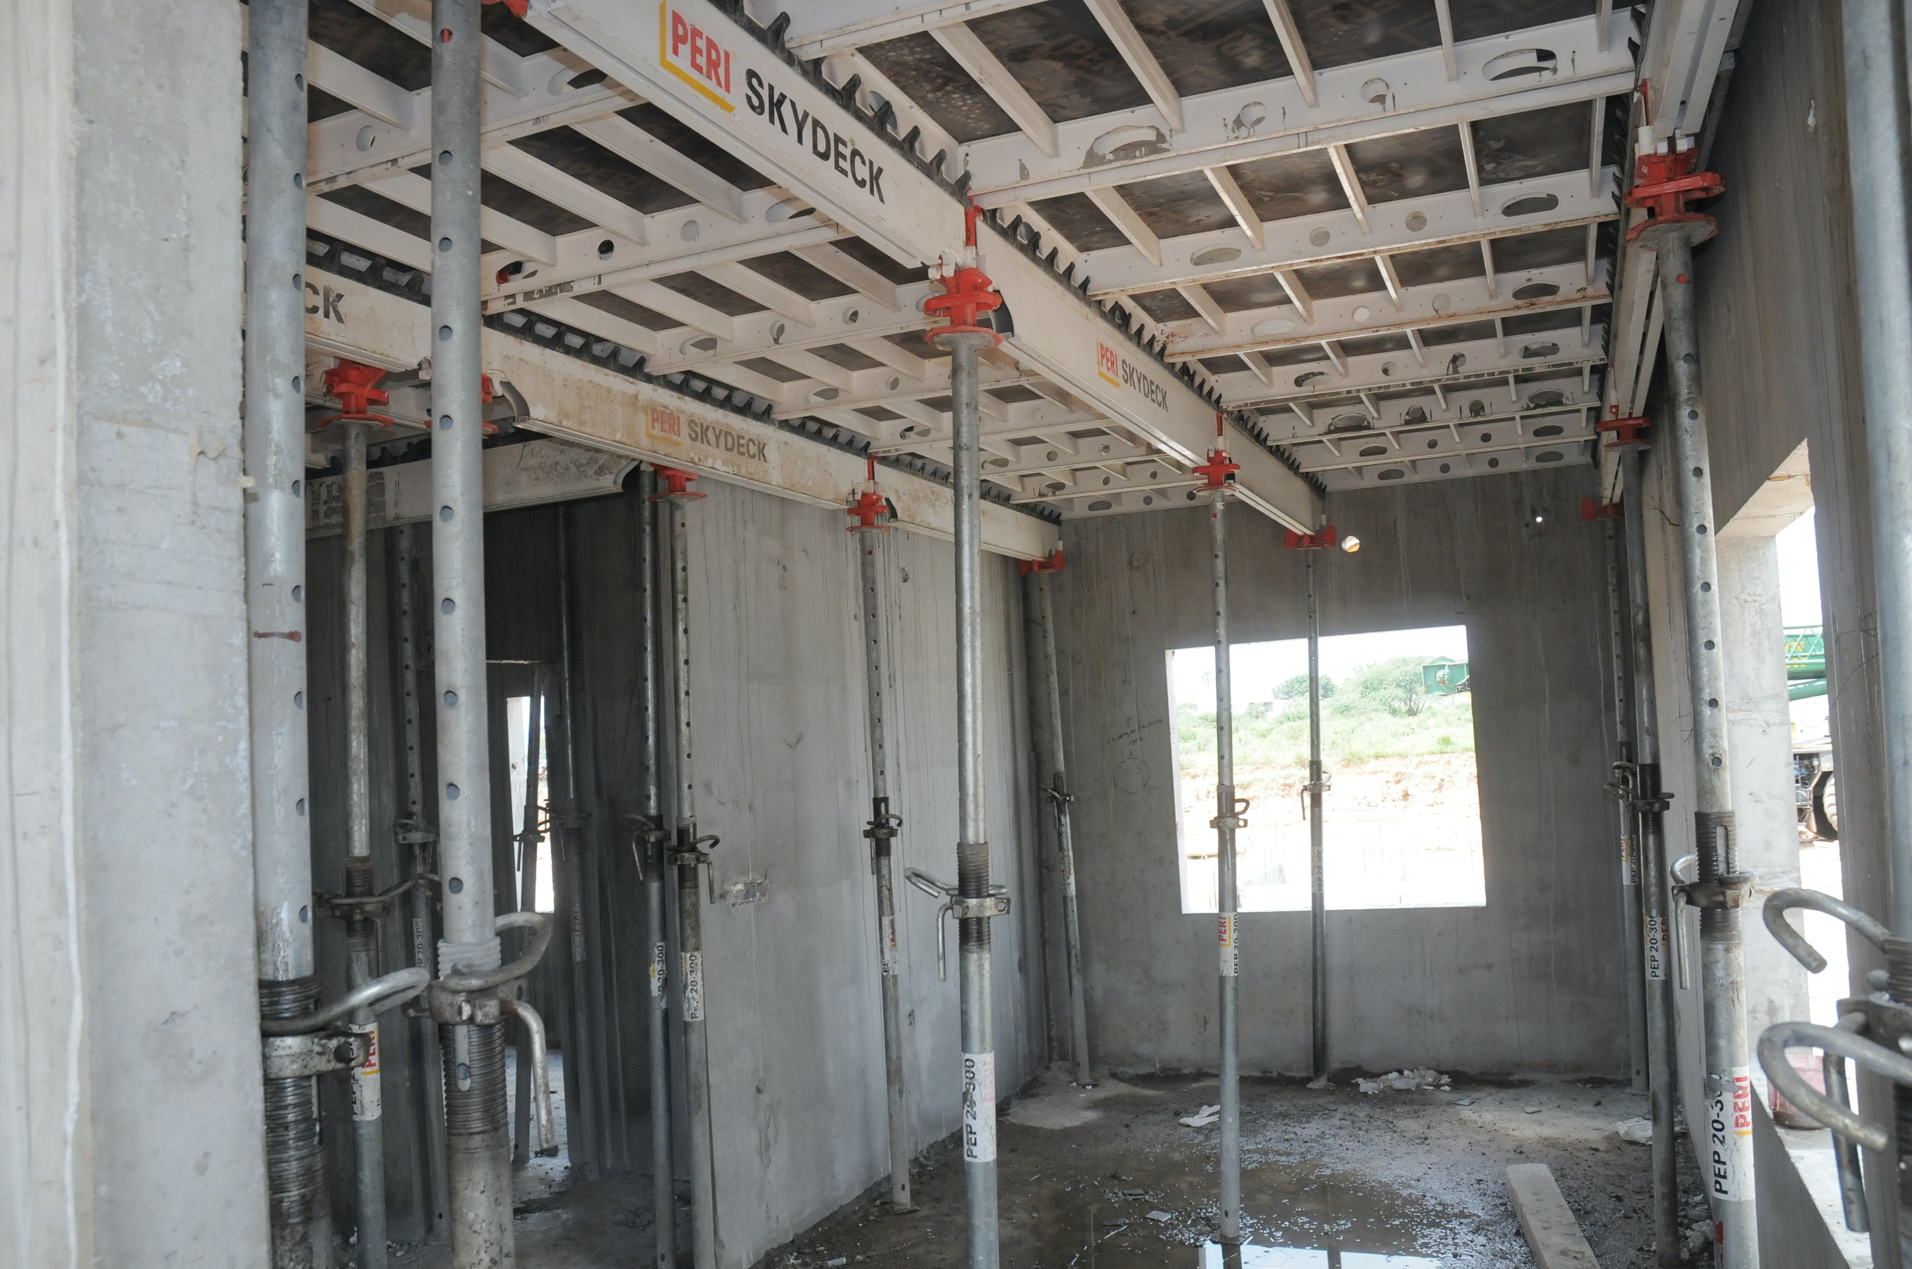
Case Study Villas
Day 9 to 12 Ground Floor Slab Cast-insitu

Slide 30
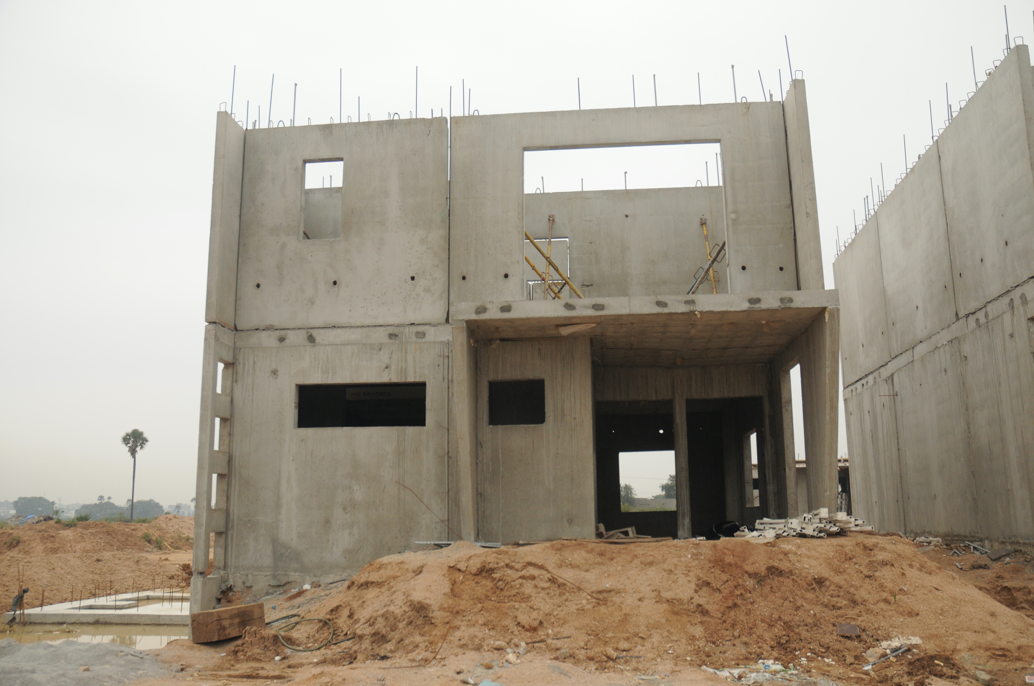
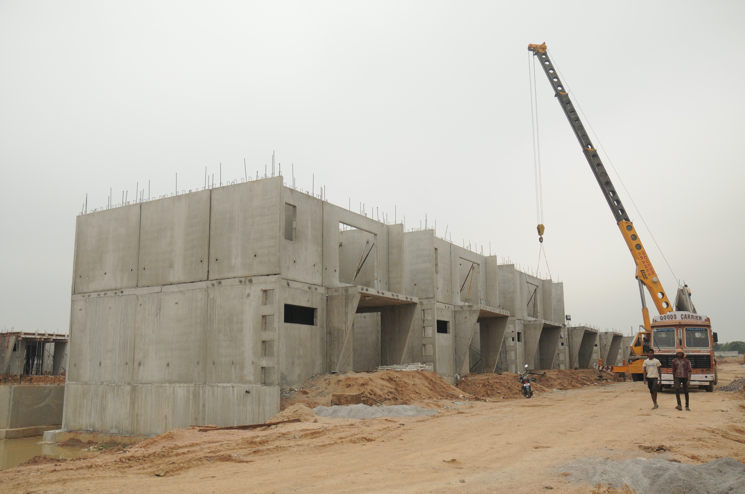
Case Study Villas
Day 13 First Floor Walls

Slide 31
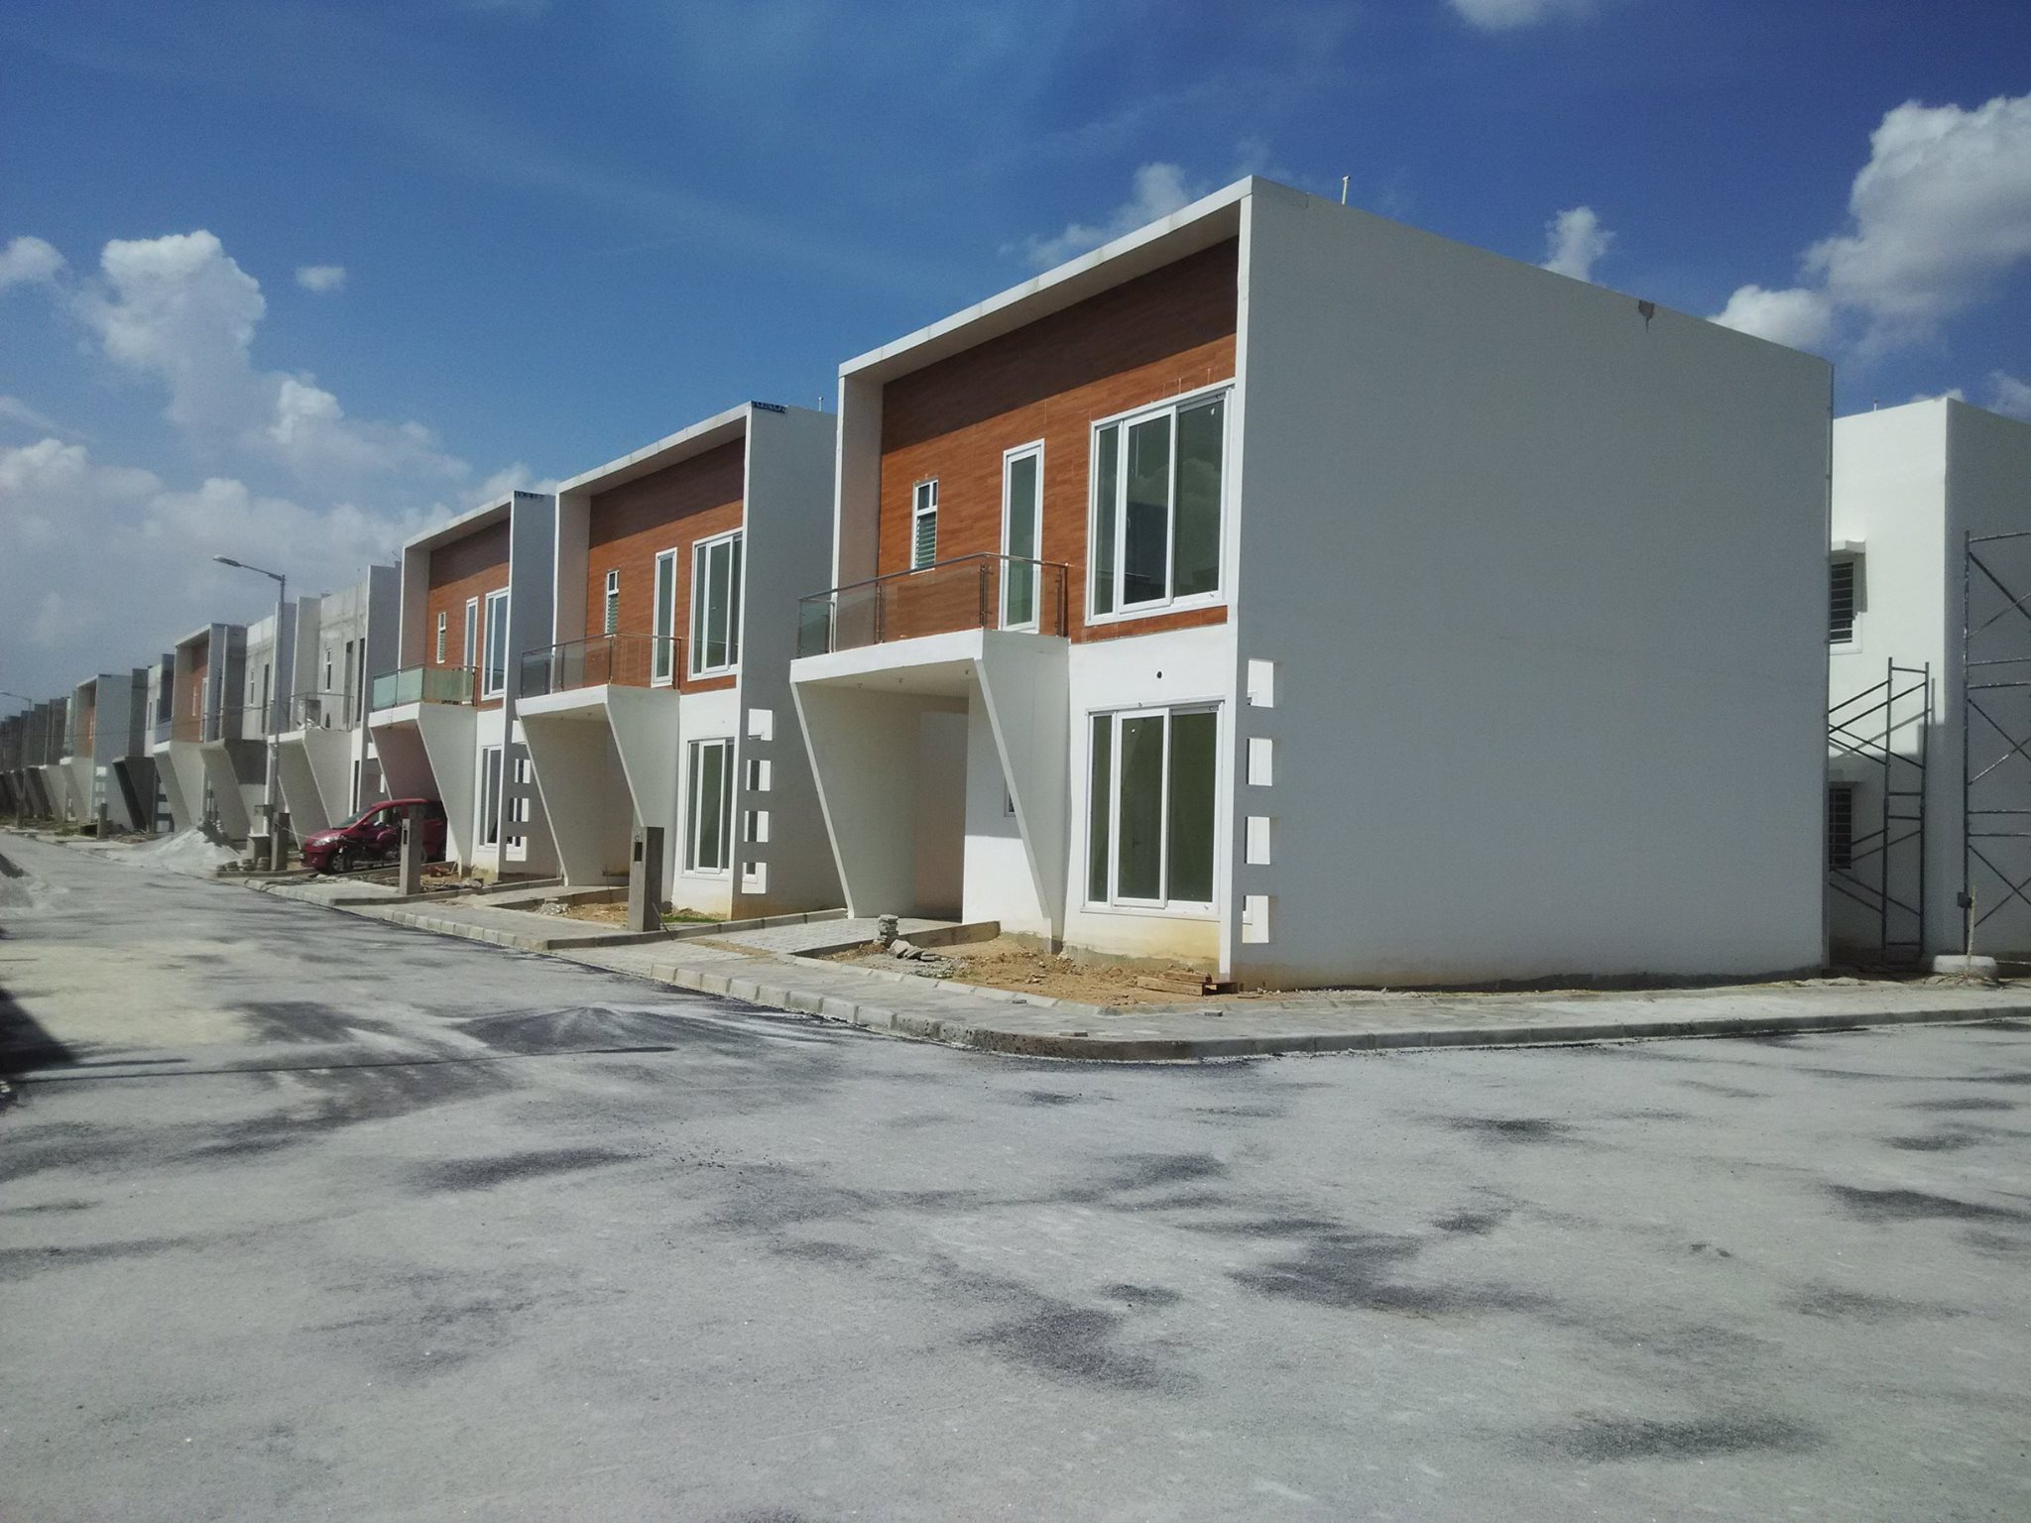
Case Study Villas
Day 14-20 First Floor Slab,
Parapet wall

Slide 32
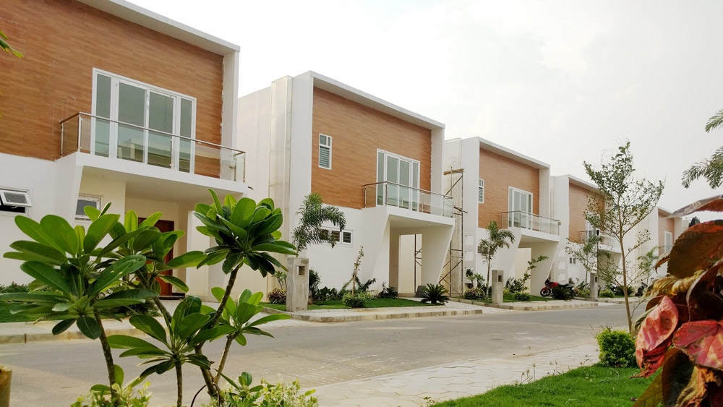
Silver Crest - Completed Project

Slide 33
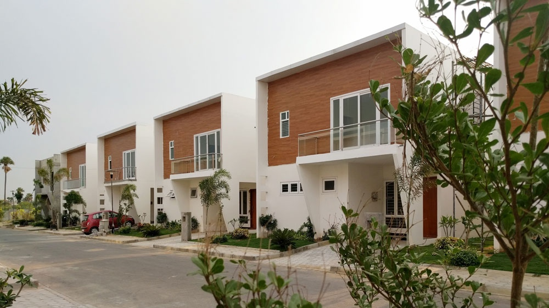
Silver Crest - Completed Project

Slide 34
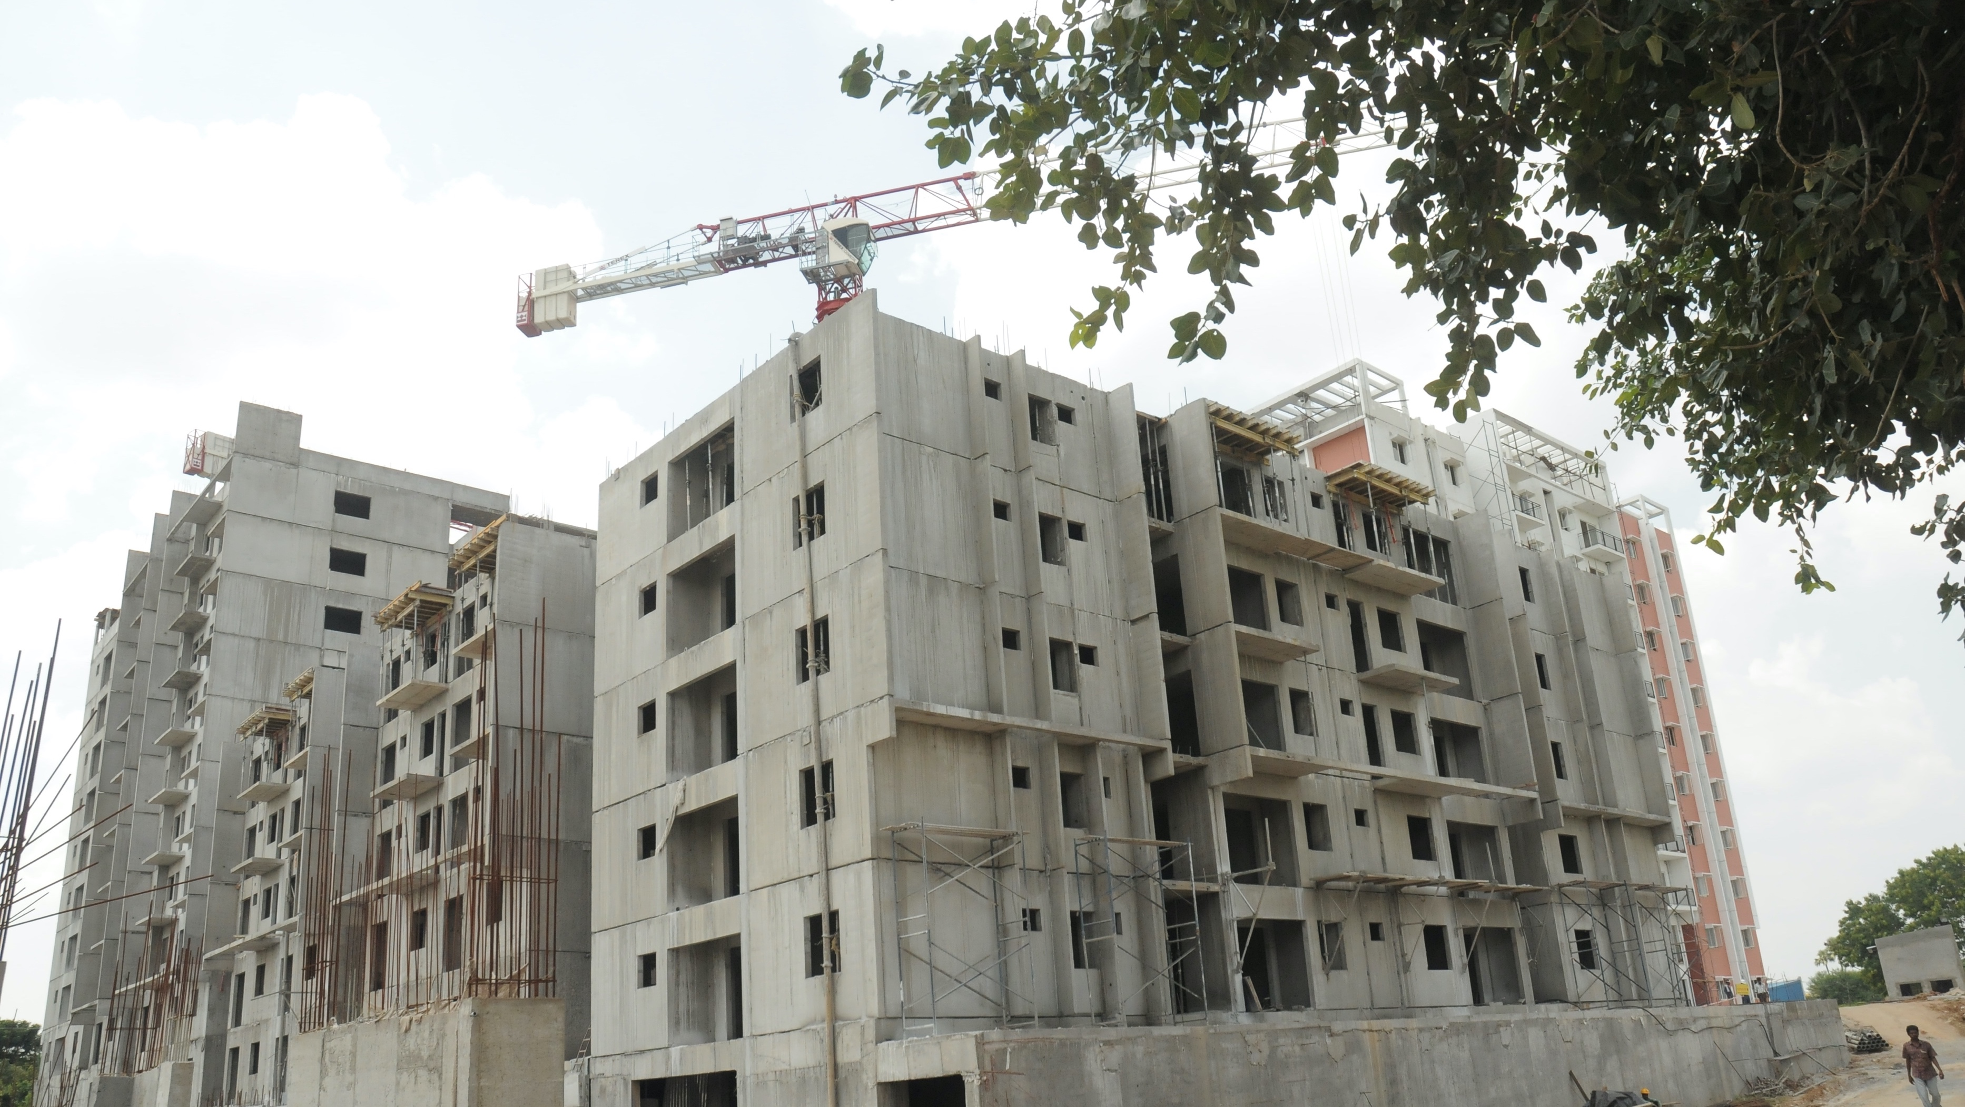
Lakefront- Under Construction

Slide 35
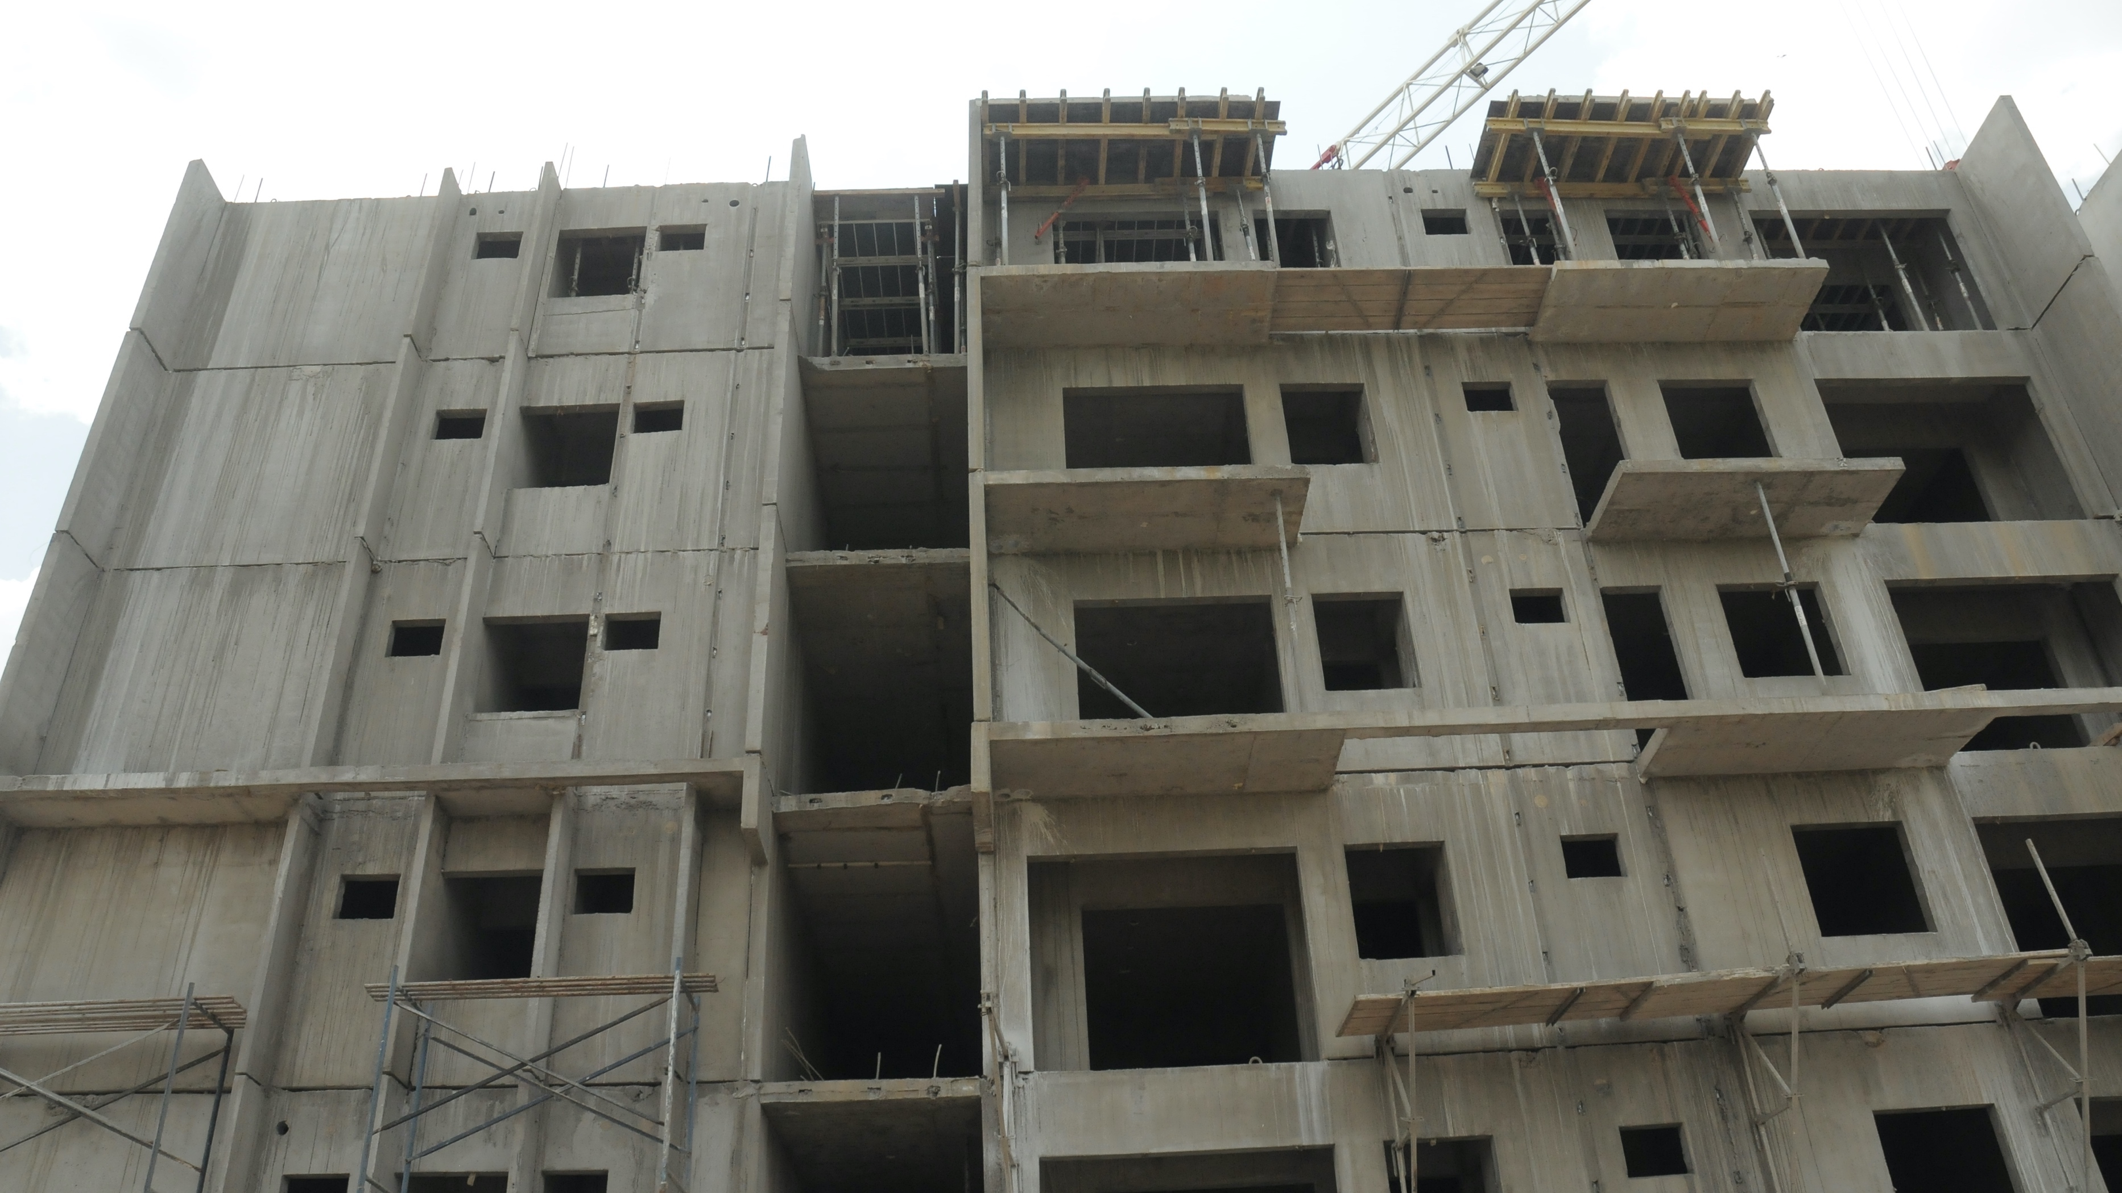
Lakefront- Under Construction

Slide 36
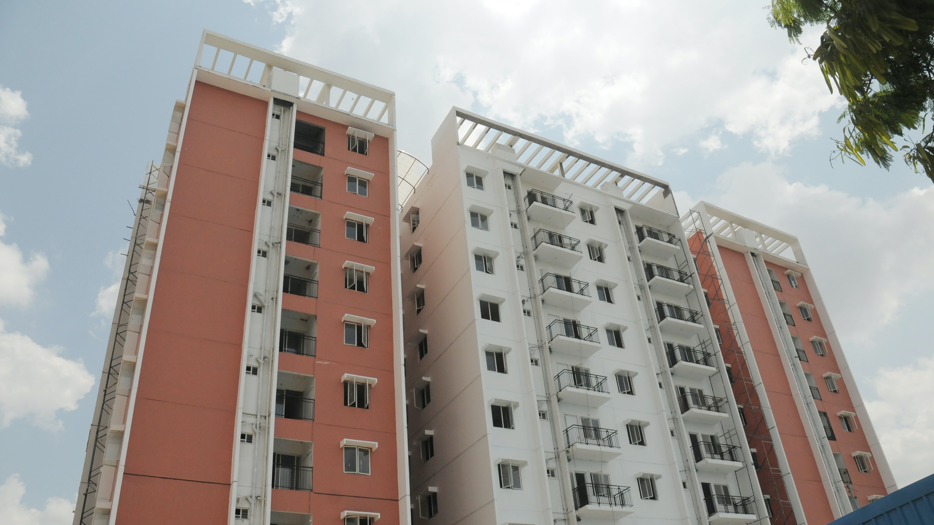
Lakefront- After Completion

Slide 37
This Photo by Unknown Author is licensed under CC BY

